Slide 1
Annual Report 2021

Slide 2
Editors
Margaret Hellard | Alisa Pedrana | Maryam Alavi
Mark Stoové | Joseph Doyle | Campbell Aitken
Gregory Dore | Alexander Thompson | Timothy Broady
Jason Grebely | Behzad Hajarizadeh | Troy Combo

Slide 3
Data contributors
Australian Collaboration for Coordinated Enhanced Sentinel Surveillance (ACCESS)
Surveillance and Treatment of Prisoners with hepatitis C (StoP-C) study
Monitoring hepatitis C treatment uptake in Australia
Real world Efficacy of Antiviral therapy in Chronic Hepatitis C in Australia project (REACH-C)
ATLAS sexual health surveillance network
Notes:
Jason Asselin and Michael Traeger
Behzad Hajarizadeh
Joanne Carson
Clare Bradley

Slide 4
Data contributors
Australian Needle Syringe Program Survey (ANSPS)
ETHOS Engage study
National Prisons Hepatitis Network (NPHN)
National hepatitis C diagnosis and care cascade
Australia and New Zealand Liver and Intestinal Transplant Registry (ANZLITR)
Notes:
Jenny Iversen and Lisa Maher
Heather Valerio
Yumi Sheehan and Rebecca Winter
Amy Kwon and Richard Gray
Mandy Bryne

Slide 5
Data contributors
Viral Hepatitis Mapping Project
Stigma Indicators Monitoring Project
Gay Community Periodic Survey
HCV Estimates and Projections Reference Group (Kirby Institute)
Viral Hepatitis working group (Burnet Institute)
Notes:
Jenn MacLachalan
Tim Broady
Martin Holt, Limin Mao, Tim Broady
Amy Kwon
Nick Scott

Slide 6
Suggested citation:
Burnet Institute and Kirby Institute. Australia’s progress towards hepatitis C elimination: annual report 2021. Melbourne: Burnet Institute; 2021.

Slide 7
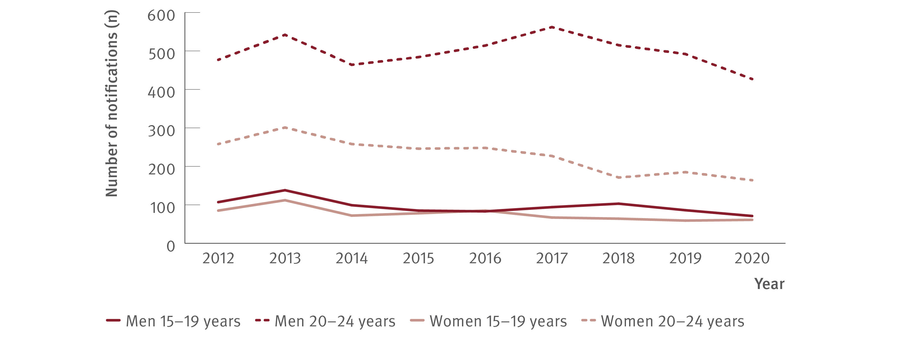
Figure 1. Number of hepatitis C (unspecified) notifications by age group and gender, 2012–2020
New infections
Source: Australian National Notifiable Diseases Surveillance System.⁽⁷⁾
Notes:
Notes: Cases other than newly acquired are assigned as unspecified.

Slide 8
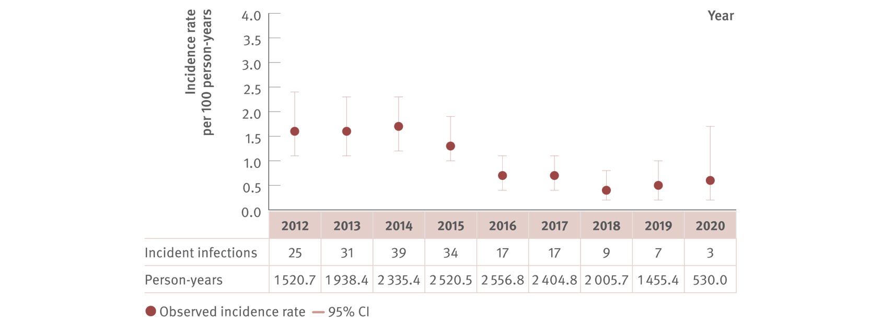
Figure 2. Incidence of primary hepatitis C infection among individuals tested at ACCESS primary care clinics, ACCESS, 2012–2020
New infections
Source: ACCESS.⁽⁹⁾
Notes:
Notes: N=6 593. Analysis includes 11 sites: nine in VIC, one in Western Australia (WA), and one in Queensland (QLD). The WA site contributed data from 2016 onwards. Primary care clinics see high caseloads of people at risk of hepatitis C and provide both specialist services to current or former PWID as well as general health services. First incident infection only included in analysis. Incident infection date was assigned as the midpoint between the positive HCV antibody or HCV RNA test date and previous HCV antibody negative test date. ACCESS collates data from January 2009. Individuals included tested HCV antibody negative on their first test observed and had at least one follow‑up test (HCV antibody or HCV RNA or both before 31st December 2020). Individuals were 15 years or older. CI: confidence interval.

Slide 9
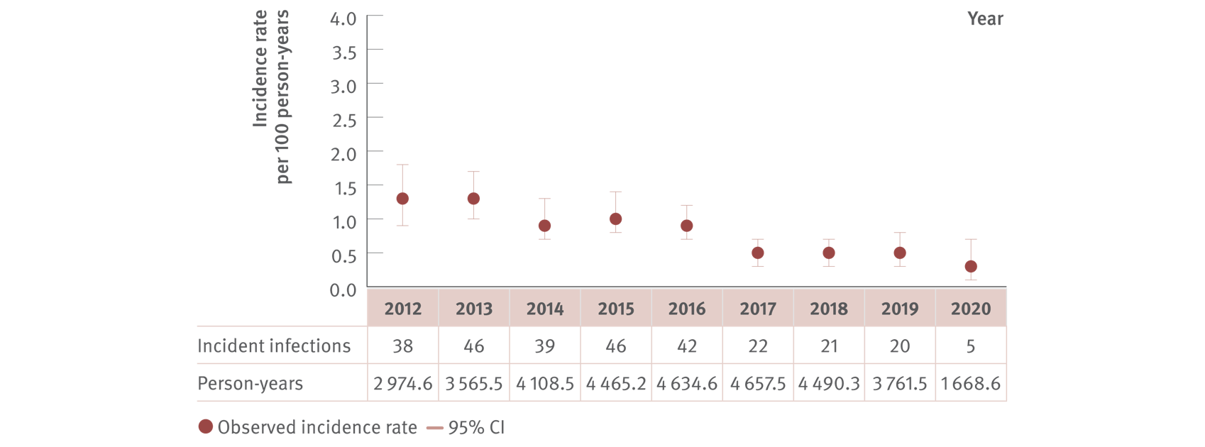
Figure 3. Incidence of primary hepatitis C infection among HIV‑positive GBM tested at ACCESS GBM or sexual health clinics, ACCESS, 2012–2020
New infections
Source: ACCESS.⁽⁹⁾
Notes:
Notes: N=7 076. Analysis includes 20 sites: nine in NSW, four in VIC, two in South Australia (SA), two in Australian Capital Territory (ACT), one in WA, one in QLD, and one in Tasmania (TAS). The TAS site contributed data from 2013 onwards. GBM were classed as being HIV‑positive for the entire calendar year of their diagnosis and were 15 years or older. First incident infection only included in analysis. Incident infection date was assigned as the midpoint between the positive HCV antibody or HCV RNA test date and previous HCV antibody negative test date. ACCESS collates data from January 2009. Individuals included tested HCV antibody negative on their first test observed, and had at least one follow‑up test (HCV antibody or HCV RNA or both before 31st December 2020). CI: confidence interval.

Slide 10
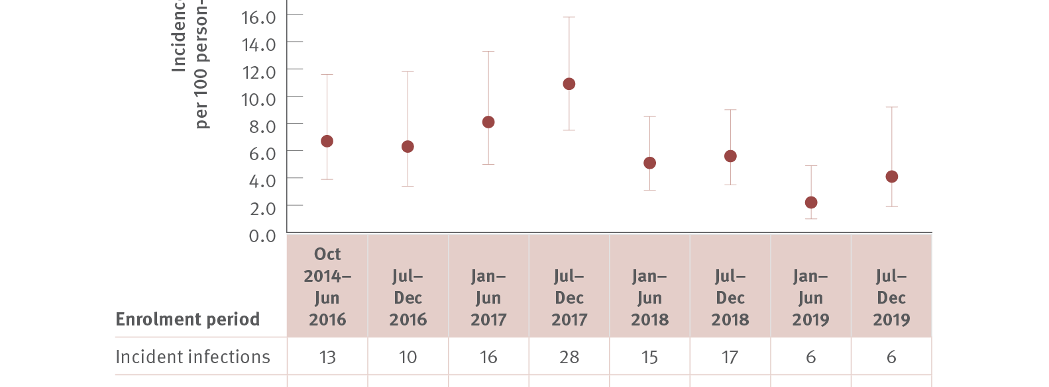
Figure 4. Incidence of hepatitis C infection among people in prison participating in the SToP‑C study, 2014–2019
New infections
Source: Hajarizadeh et al., Lancet Gastroenterol Hepatol 2021.⁽¹²⁾
Notes:
Notes: The time period between October 2014 and June 2016, was merged to increase person‑years of follow‑up. CI: confidence interval.

Slide 11
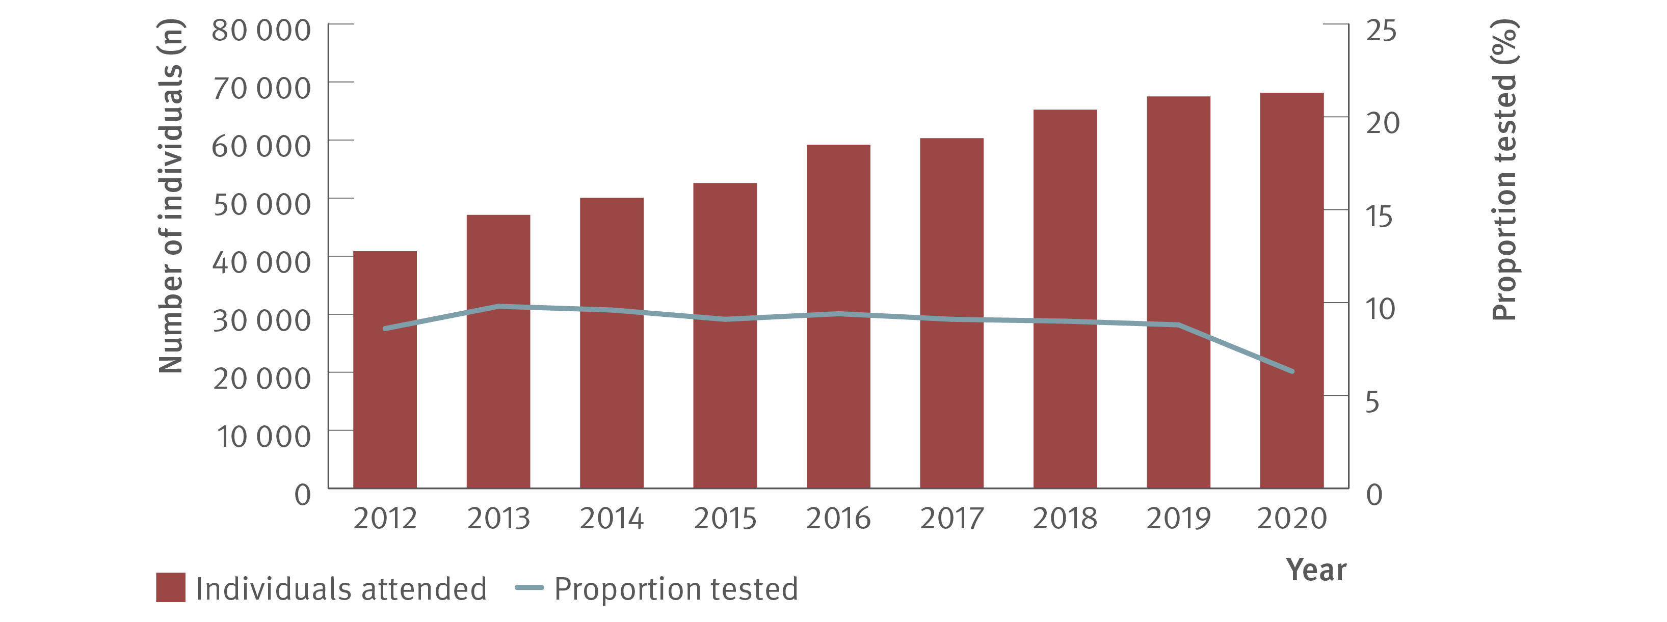
Figure 5. Number of individuals attending ACCESS primary care clinics and proportion tested for HCV (HCV antibody only or HCV antibody and RNA or HCV RNA only), ACCESS, 2012–2020
Testing and diagnosis
Source: ACCESS.⁽⁹⁾
Notes:
Notes: Analysis includes 11 sites: nine in VIC, one in WA, and one in QLD. The WA site contributed data from 2016 onwards. Primary care clinics have high caseloads of people at risk of hepatitis C and provide both specialist services to current and former PWID as well as general health services. Clinic attendances included in‑person and telehealth consultations. Individuals were 15 years or older and contributed one consultation and one test per year.

Slide 12
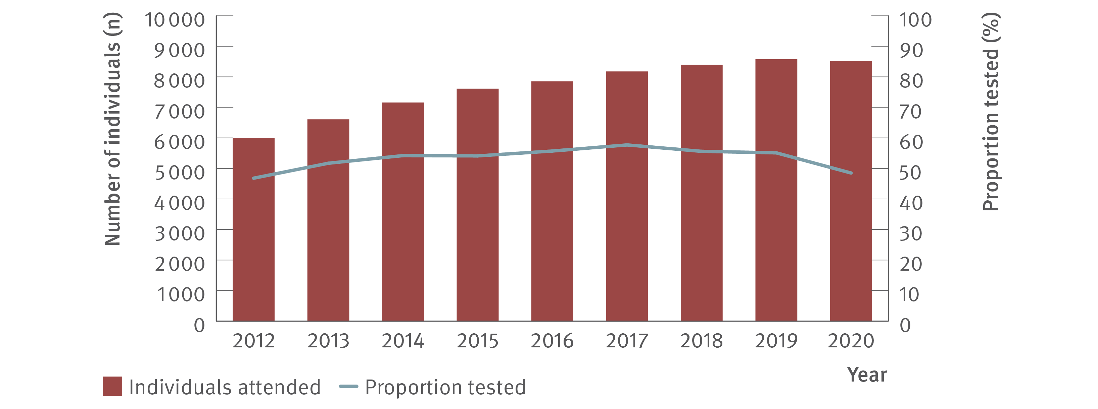
Figure 6. Number of HIV‑positive GBM attending ACCESS GBM or sexual health clinics and proportion tested for HCV (HCV antibody only or HCV antibody and RNA or HCV RNA only), ACCESS, 2012–2020
Testing and diagnosis
Source: ACCESS.⁽⁹⁾
Notes:
Notes: Analysis includes 20 sites: nine in NSW, four in VIC, two in SA, two in ACT, one in WA, one in QLD, and one in TAS. The TAS site contributed data from 2013 onwards. Clinic attendances included in‑person and telehealth consultations. GBM were classed as being HIV‑positive for the entire calendar year of their diagnosis, were 15 years or older, and contributed one consultation and one test per year.

Slide 13
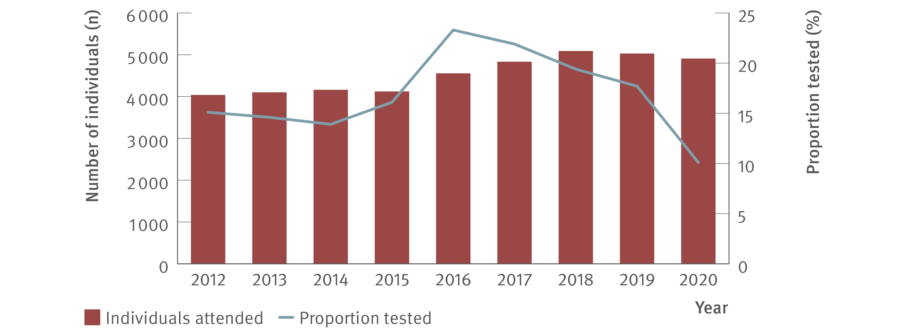
Figure 7. Number of individuals ever prescribed OAT attending ACCESS primary care clinics and proportion tested for HCV (HCV antibody only or HCV antibody and RNA or HCV RNA only), ACCESS, 2012–2020
Testing and diagnosis
Source: ACCESS.⁽⁹⁾
Notes:
Notes: Analysis includes 11 sites: nine in VIC, one in WA, and one in QLD. The WA site contributed data from 2016 onwards. Primary care clinics have high caseloads of people at risk of hepatitis C and provide both specialist services to current and former PWID as well as general health services. Clinic attendances included in‑person and telehealth consultations. Individuals were 15 years or older, had at least one electronic medical record of a prescription for OAT between January 2009 and December 2020, and contributed one consultation and one test per year.

Slide 14
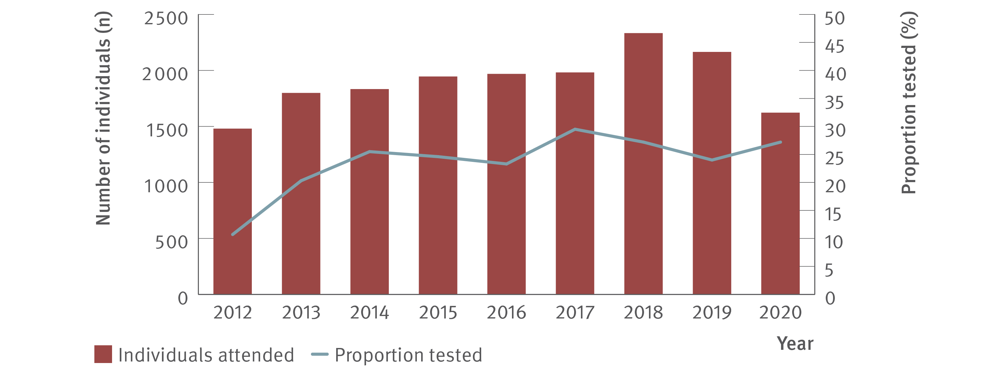
Figure 8. Number of Aboriginal and Torres Strait Islanders attending ACCESS sexual health clinics and proportion tested for HCV (HCV antibody only or HCV antibody and RNA or HCV RNA only), ACCESS, 2012–2020
Testing and diagnosis
Source: ACCESS.⁽⁹⁾
Notes:
Notes: Analysis includes 10 sites: six in NSW, one in VIC, one in ACT, one in SA, and one in TAS. The TAS site contributed data from 2013 onwards. Clinic attendances included in‑person and telehealth consultations. Individuals were 15 years or older and contributed one consultation and one test per year.

Slide 15
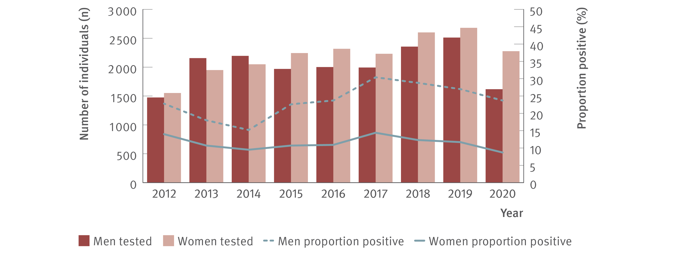
Figure 9. Number of individuals tested for HCV antibody at ACCESS primary care clinics and proportion of HCV antibody tests positive by gender, ACCESS, 2012–2020
Testing and diagnosis
Source: ACCESS.⁽⁹⁾
Notes:
Notes: Analysis includes 11 sites: nine in VIC, one in WA, and one in QLD. The WA site contributed data from 2016 onwards. Primary care clinics have high caseloads of people at risk of hepatitis C and provide both specialist services to current and former PWID as well as general health services. Clinic attendances included in‑person and telehealth consultations. Individuals were 15 years or older and contributed one test per year. Individuals recorded as ‘Other’ sex or sex was not recorded were not included due to the small sample size.

Slide 16
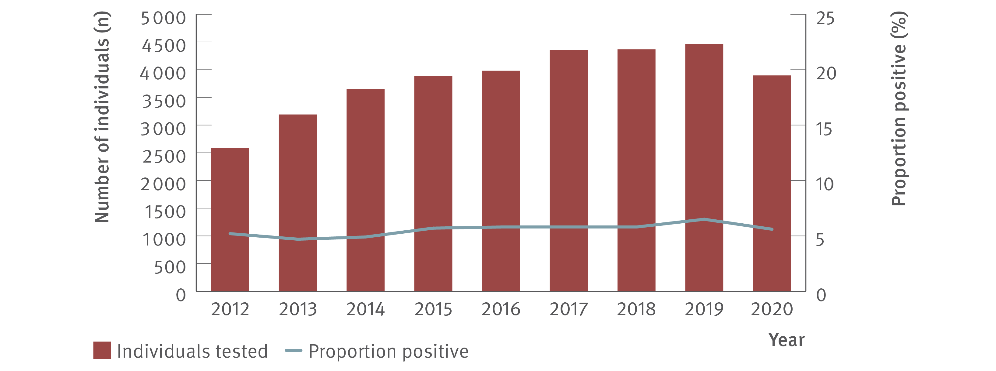
Figure 10. Number of HIV‑positive GBM tested for HCV antibody at ACCESS GBM or sexual health clinics and proportion of HCV antibody tests positive, ACCESS, 2012–2020
Testing and diagnosis
Source: ACCESS.⁽⁹⁾
Notes:
Notes: Analysis includes 20 sites: nine in NSW, four in VIC, two in SA, two in ACT, one in WA, one in QLD, and one in TAS. The TAS site contributed data from 2013 onwards. GBM were classed as being HIV‑positive for the entire calendar year of their diagnosis, were 15 years or older, and contributed one test per year.

Slide 17
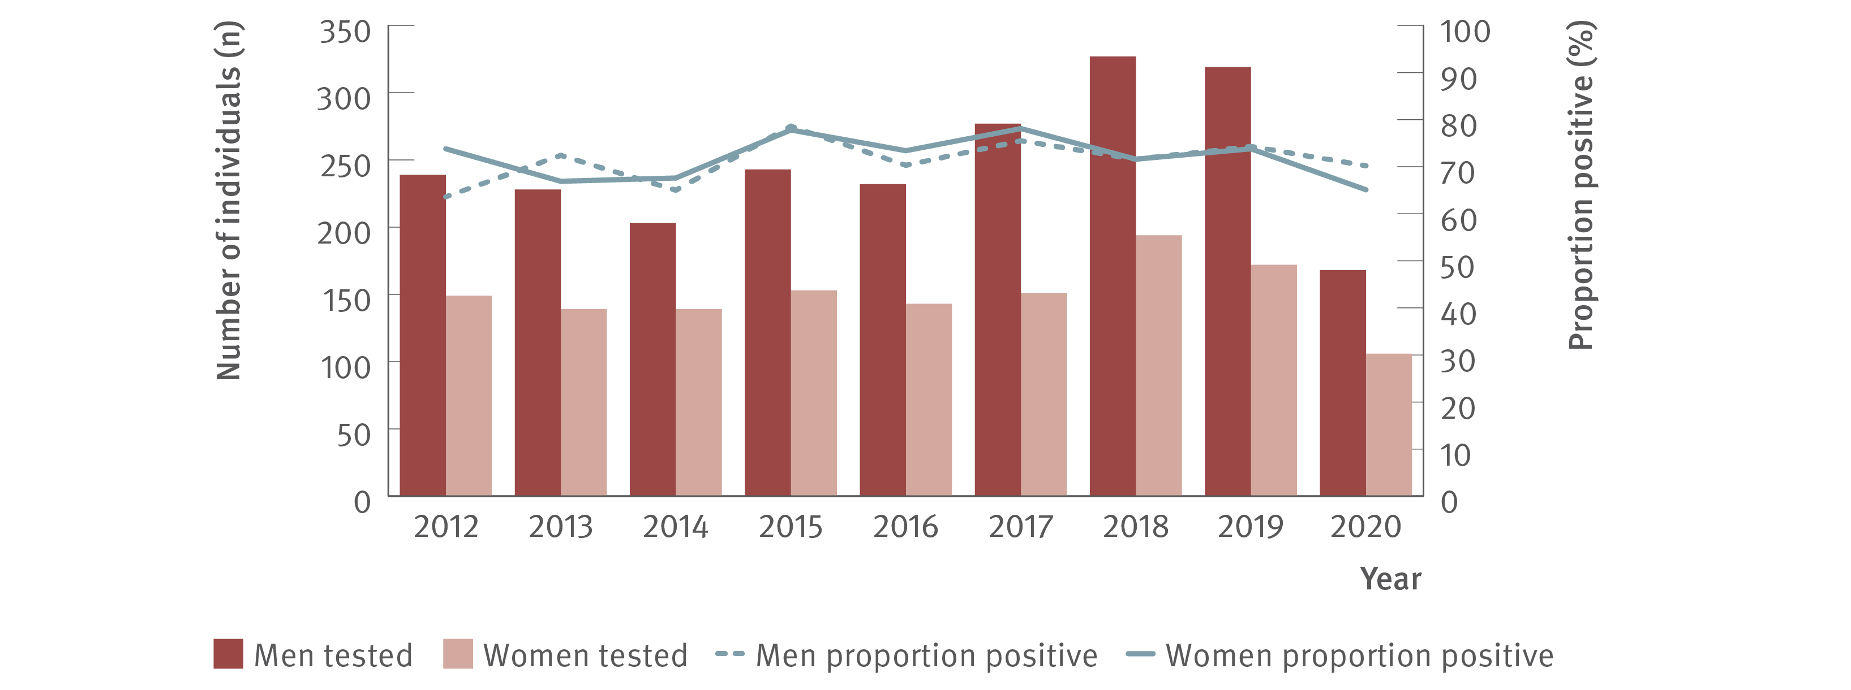
Figure 11. Number of individuals ever prescribed OAT tested for HCV antibody at ACCESS primary care clinics and proportion of HCV antibody tests positive by gender, ACCESS, 2012–2020
Testing and diagnosis
Source: ACCESS.⁽⁹⁾
Notes:
Notes: Analysis includes 11 sites: nine in VIC, one in WA, and one in QLD. The WA site contributed data from 2016 onwards. Primary care clinics have high caseloads of people at risk of hepatitis C and provide both specialist services to current and former PWID as well as general health services. Individuals were 15 years or older, had at least one electronic medical record of a prescription for OAT between January 2009 and December 2020, and contributed one test per year. Individuals recorded as ‘Other’ sex or sex was not recorded were not included due to the small sample size.

Slide 18
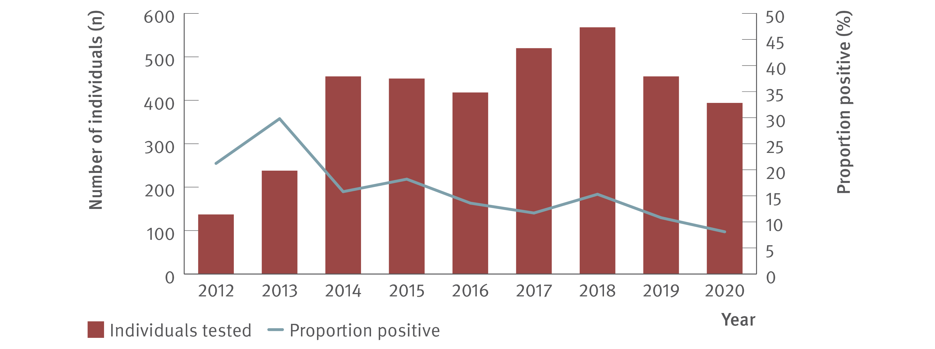
Figure 12. Number of Aboriginal and Torres Strait Islanders tested for HCV antibody at ACCESS sexual health clinics and proportion of HCV antibody tests positive, ACCESS, 2012–2020
Testing and diagnosis
Source: ACCESS.⁽⁹⁾
Notes:
Notes: Analysis includes 10 sites: six in NSW, one in VIC, one in ACT, one in SA, and one in TAS. The TAS site contributed data from 2013 onwards. Clinic attendances included in‑person and telehealth consultations. Individuals were 15 years or older and contributed one test per year.

Slide 19
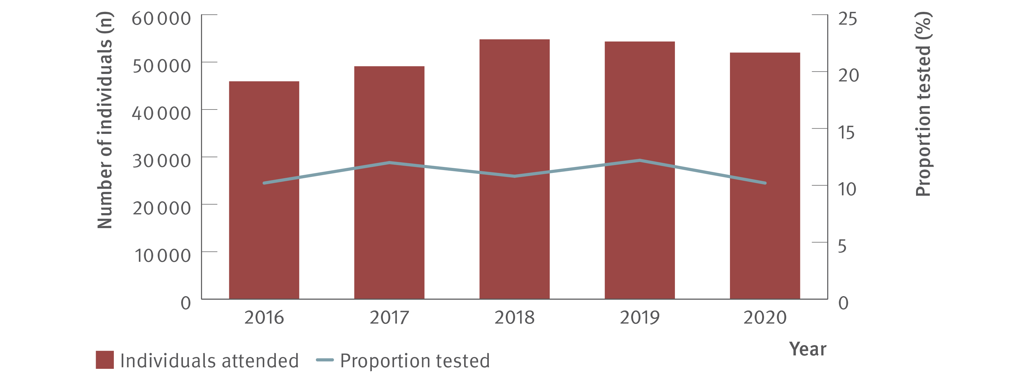
Figure 13. Number of individuals attending ACCHSs and proportion tested for HCV (HCV antibody only or HCV antibody and RNA or HCV RNA only), ATLAS network, 2016–2020
Testing and diagnosis
Source: ATLAS sexual health surveillance network, 2016–2020.⁽¹⁷⁾
Notes:
Notes: Individuals defined as people aged 15 years or older, who visited a doctor, nurse, or Aboriginal health practitioner (‘medical consultations’) between 2016 and 2020.

Slide 20
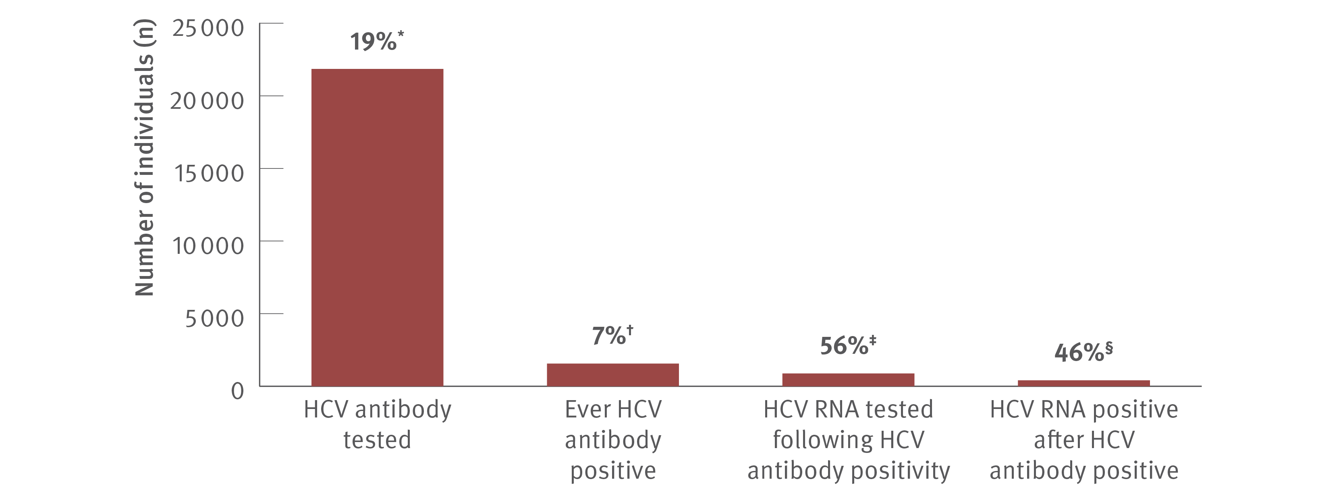
Figure 14. Hepatitis C testing cascade: number and proportion of individuals attending ACCHSs tested for HCV antibody or RNA and among those tested, the number and proportion testing positive, ATLAS network, aggregated for years 2016–2020
Testing and diagnosis
Source: ATLAS sexual health surveillance network, 2016–2020.⁽¹⁷⁾
Notes:
Notes: Individuals defined as people aged 15 years or older, who visited a doctor, nurse, or Aboriginal health practitioner (‘medical consultations’) between 2016 and 2020. ‘Ever HCV antibody positive’ is defined as having had a positive test result at any time since data collection began (1st January 2016) until end of the sample period (December 2020). *A total of 117 549 individuals aged 15 years or older attended medical appointments between 2016 and 2020, of whom 18.6% (21 849/117 549) had an HCV antibody test. †Of those tested for HCV antibody, 7.1% (1 558/21 849) tested HCV antibody positive. ‡Of those HCV antibody positive, 56.4% (878/1 158) had an HCV RNA test following HCV antibody positivity of which §46.2% (406/878) were HCV RNA positive.

Slide 21
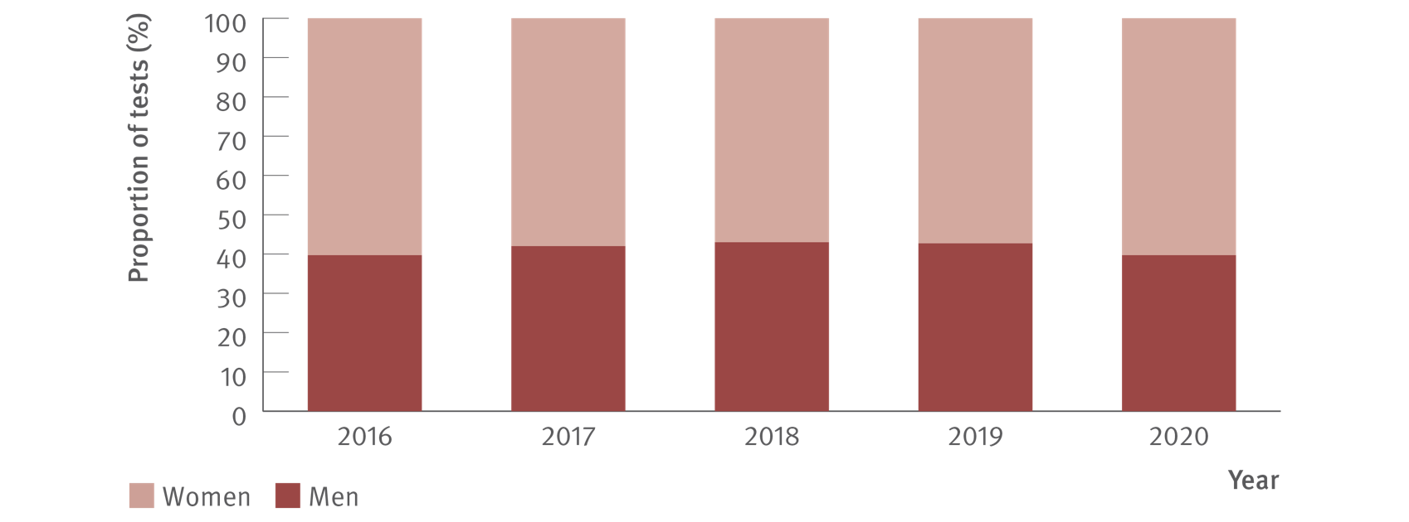
Figure 15. Proportion of HCV tests (HCV antibody only or HCV antibody and RNA or HCV RNA only) at ACCHSs by gender, ATLAS network, 2016–2020
Testing and diagnosis
Source: ATLAS sexual health surveillance network, 2016–2020.⁽¹⁷⁾
Notes:
Notes: Individuals defined as people aged 15 years or older, who visited a doctor, nurse, or Aboriginal health practitioner (‘medical consultations’) between 2016 and 2020. Number of people tested per year as follows: 2016: 1 868 men, 2 836 women; 2017: 2 476 men, 3 426 women; 2018: 2 536 men, 3 363 women; 2019: 2 841 men, 3 811 women; 2020: 2 110 men, 3 202 women.

Slide 22
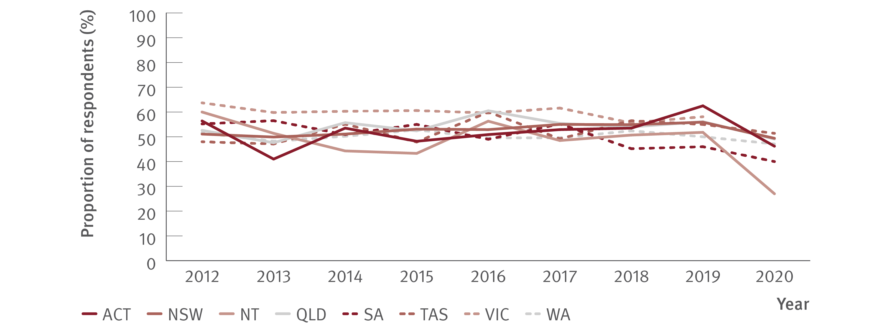
Figure 16. Proportion of ANSPS respondents self‑reporting recent (past 12 months) hepatitis C testing by jurisdiction, 2012–2020
Testing and diagnosis
Source: Australian Needle Syringe Program Survey. National Data Report 2016–2020.⁽¹⁸⁾
Notes:
Notes: No participant recruitment occurred in VIC in 2020.

Slide 23
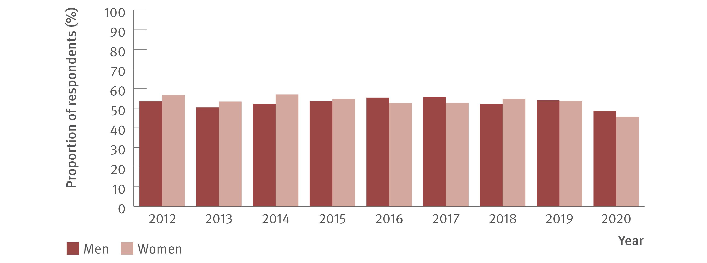
Figure 17. Proportion of ANSPS respondents reporting recent (past 12 months) hepatitis C testing by gender, 2012–2020
Testing and diagnosis
Source: Australian Needle Syringe Program Survey. National Data Report 2016–2020.⁽¹⁸⁾
Notes:
Notes: No participant recruitment occurred in VIC in 2020.

Slide 24
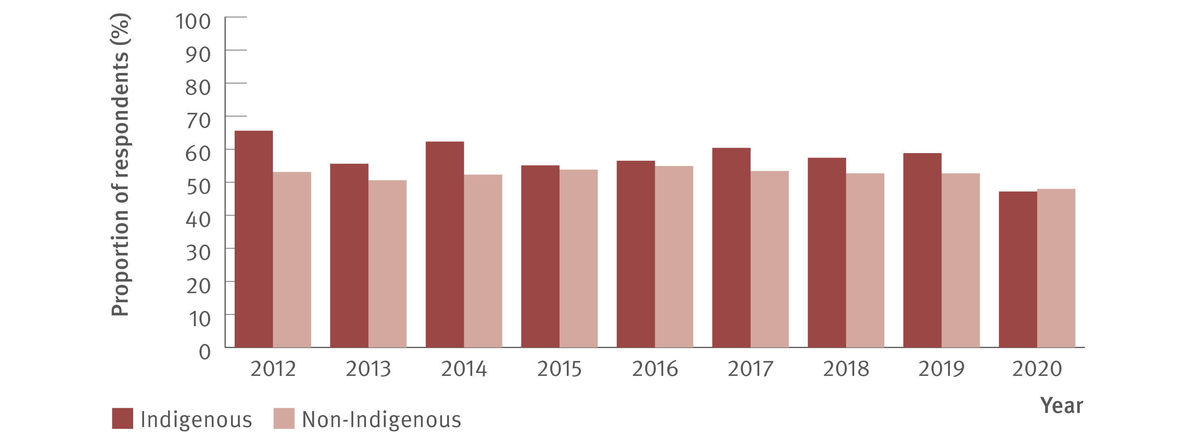
Figure 18. Proportion of ANSPS respondents reporting recent (past 12 months) hepatitis C testing by Indigenous status, 2012–2020
Testing and diagnosis
Source: Australian Needle Syringe Program Survey. National Data Report 2016–2020.⁽¹⁸⁾
Notes:
Notes: No participant recruitment occurred in VIC in 2020.

Slide 25
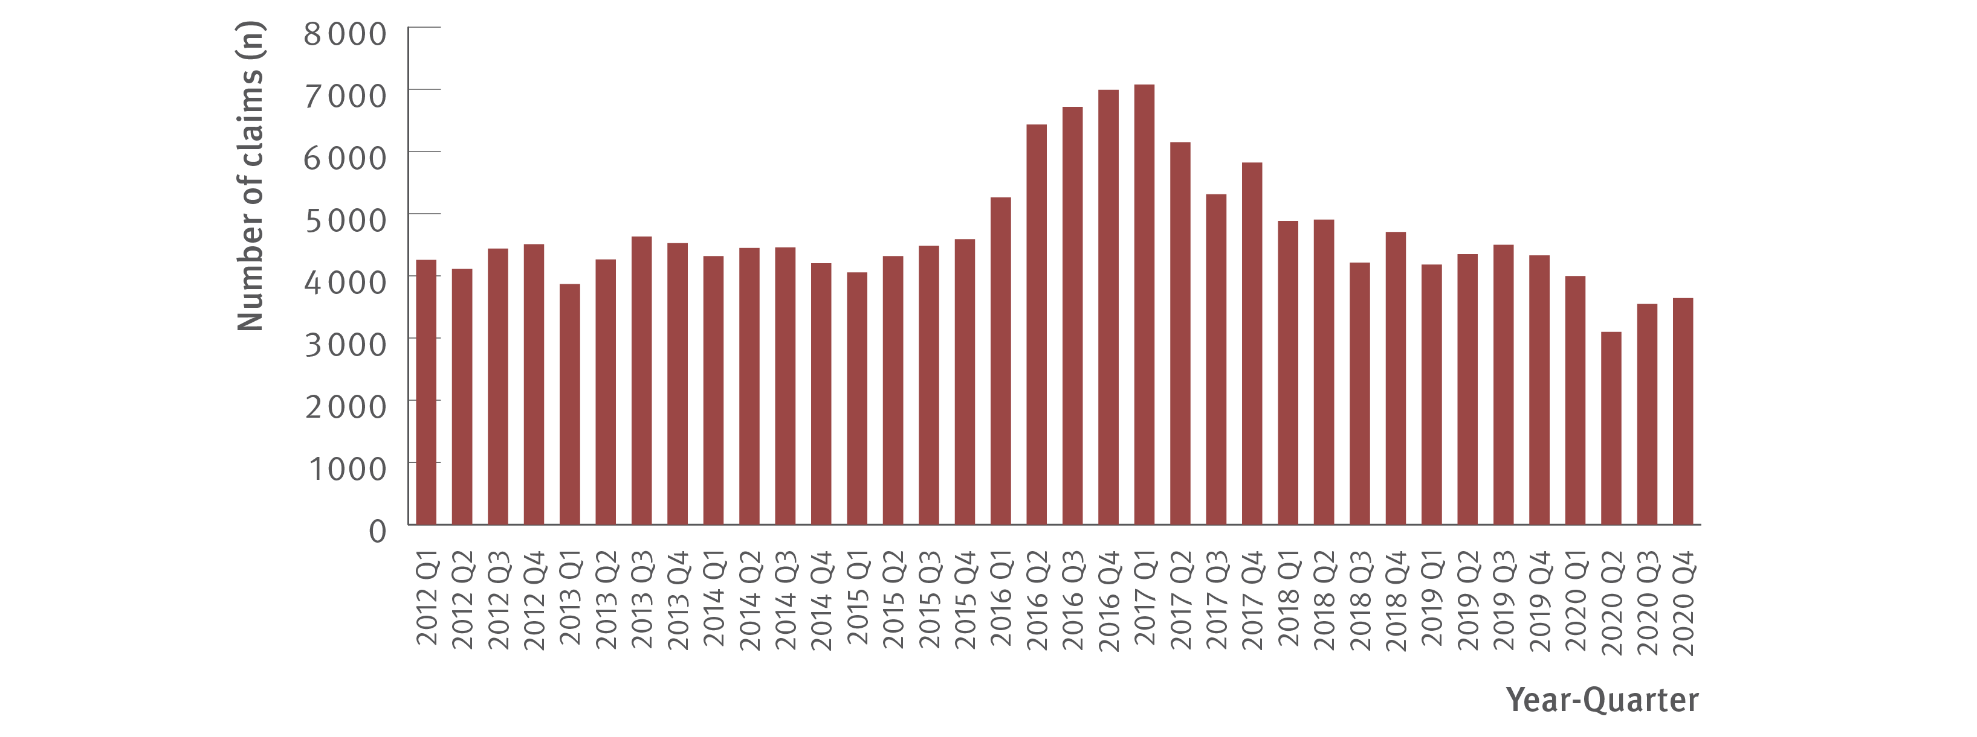
Figure 19. Number of claims to Medicare for items 69499 and 69500 (detection of HCV RNA, new infections only), 2012–2020
Testing and diagnosis
Source: Medicare Australia Statistics.⁽¹⁹⁾
Notes:
Notes: MBS item numbers (69499 and 69500) are used for testing to detect current hepatitis C infection and not used for tests associated with treatment monitoring. Prison‑based testing not included in MBS data.

Slide 26
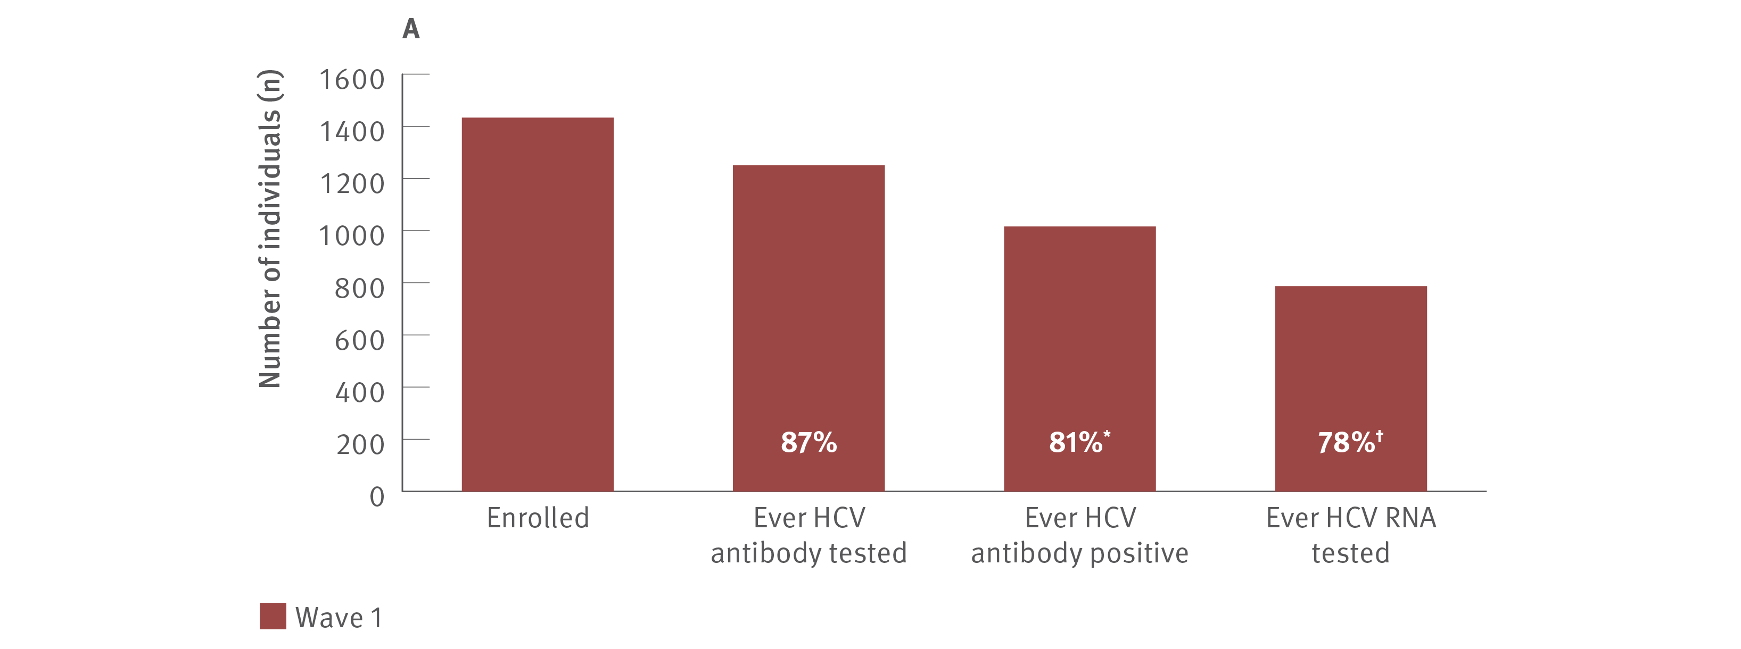
Figure 20. Number of individuals enrolled in ETHOS Engage who were HCV antibody tested, HCV antibody positive and HCV RNA tested, A: Wave 1 (May 2018–September 2019) and B: Wave 2 (November 2019–June 2021)
Testing and diagnosis
Source: ETHOS Engage study.⁽²⁰⁾ Wave 2 data, ETHOS Engage study, unpublished data.
Notes:
Notes: ETHOS Engage was conducted over two distinct recruitment waves: A: Wave 1 (May 2018–September 2019) and B: Wave 2 (November 2019–June 2021). 1 433 participants were recruited in Wave 1 and 1 211 participants were recruited in Wave 2. Recruitment was from the same drug and alcohol treatment, OAT, and NSP sites, 12–36 months apart (21 sites participating in both; 25 sites Wave 1; 21 sites Wave 2), with sites in NSW, QLD, SA, and WA. ‘Ever HCV antibody positive’ was determined by a combination of results obtained from point‑of‑care HCV RNA testing and self‑report. All participants who tested positive at point‑of‑care, who indicated ever receiving treatment, or had indicated ever being infected with HCV, were considered HCV antibody positive. ‘Ever RNA tested’ determined by self‑reported HCV RNA testing at enrolment. *Of those HCV antibody tested. †Of those HCV antibody positive.

Slide 27
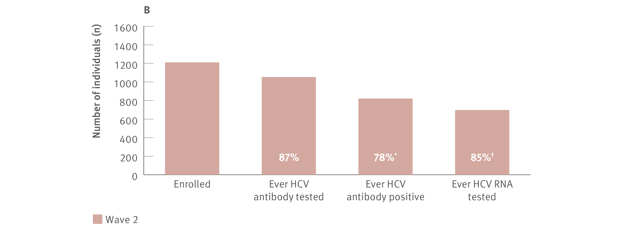
Figure 20. Number of individuals enrolled in ETHOS Engage who were HCV antibody tested, HCV antibody positive and HCV RNA tested, A: Wave 1 (May 2018–September 2019) and B: Wave 2 (November 2019–June 2021)
Testing and diagnosis
Source: ETHOS Engage study.⁽²⁰⁾ Wave 2 data, ETHOS Engage study, unpublished data.
Notes:
Notes: ETHOS Engage was conducted over two distinct recruitment waves: A: Wave 1 (May 2018–September 2019) and B: Wave 2 (November 2019–June 2021). 1 433 participants were recruited in Wave 1 and 1 211 participants were recruited in Wave 2. Recruitment was from the same drug and alcohol treatment, OAT, and NSP sites, 12–36 months apart (21 sites participating in both; 25 sites Wave 1; 21 sites Wave 2), with sites in NSW, QLD, SA, and WA. ‘Ever HCV antibody positive’ was determined by a combination of results obtained from point‑of‑care HCV RNA testing and self‑report. All participants who tested positive at point‑of‑care, who indicated ever receiving treatment, or had indicated ever being infected with HCV, were considered HCV antibody positive. ‘Ever RNA tested’ determined by self‑reported HCV RNA testing at enrolment. *Of those HCV antibody tested. †Of those HCV antibody positive.

Slide 28
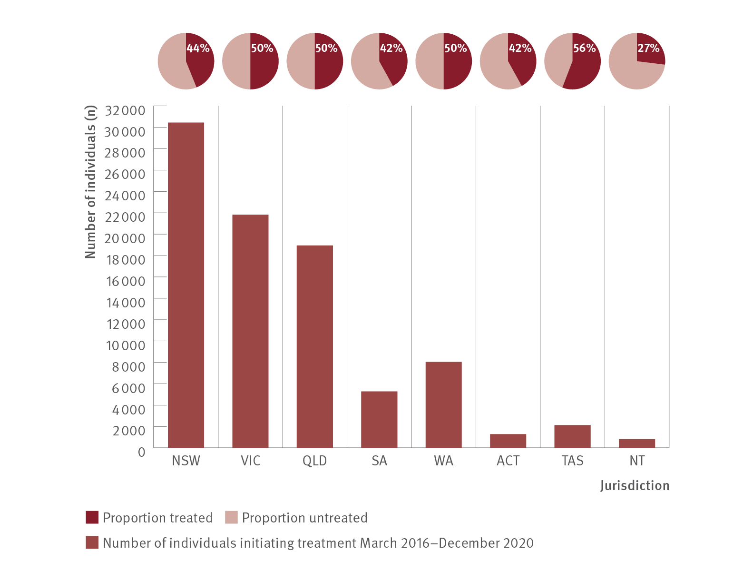
Figure 21. Estimated number of individuals initiating DAA treatment and the proportion of individuals living with chronic hepatitis C who initiated DAA treatment by jurisdiction, PBS database, March 2016–December 2020
Uptake of treatment
Source: Monitoring hepatitis C treatment uptake in Australia.^{(2,25)}
Notes:
Notes: Treatment numbers may vary from previous or future reports due to refinements made to the PBS data between releases. Estimated proportion of individuals living with chronic hepatitis C who initiated DAA treatment was based on people living with chronic hepatitis C by the end of 2015 and does not encompass individuals with new infections from 2016, some of whom will have been treated.

Slide 29
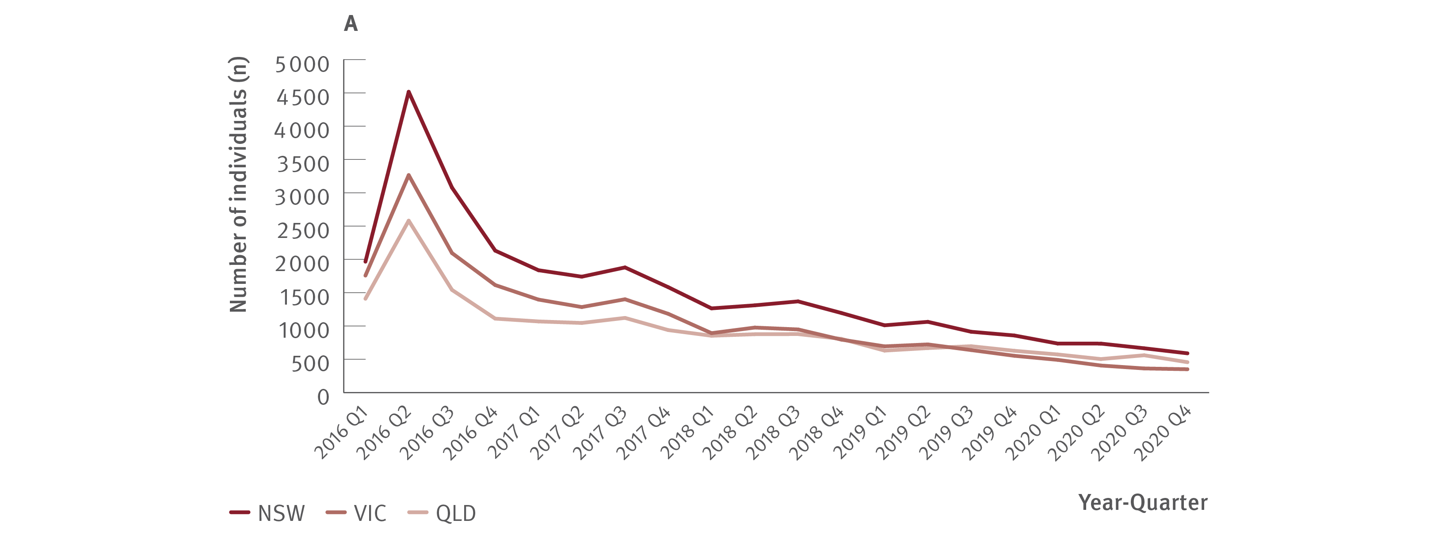
Figure 22. Estimated number of individuals initiating DAA treatment by jurisdiction, PBS database, March 2016–December 2020
Uptake of treatment
Source: Monitoring hepatitis C treatment uptake in Australia.^{(2,25)}
Notes:
Notes: 2016 Q1 is data from March 2016 only. Treatment numbers may vary from previous or future reports due to refinements made to the PBS data between releases.

Slide 30
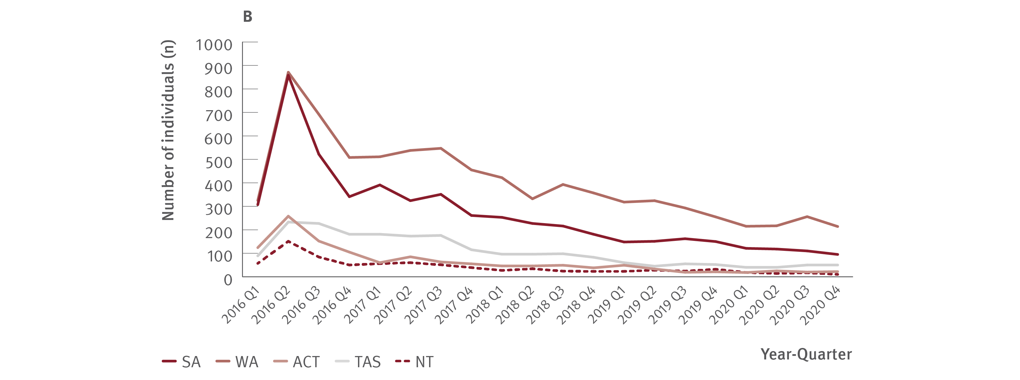
Figure 22. Estimated number of individuals initiating DAA treatment by jurisdiction, PBS database, March 2016–December 2020
Uptake of treatment
Source: Monitoring hepatitis C treatment uptake in Australia.^{(2,25)}
Notes:
Notes: 2016 Q1 is data from March 2016 only. Treatment numbers may vary from previous or future reports due to refinements made to the PBS data between releases.

Slide 31
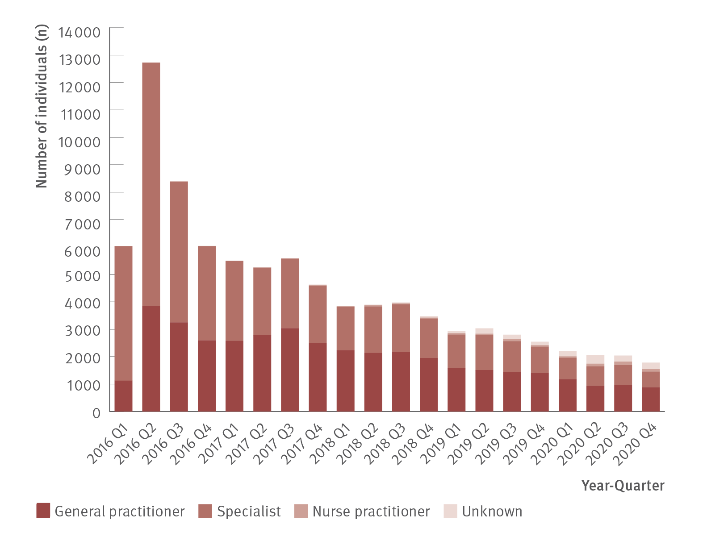
Figure 23. Estimated number of individuals initiating DAA treatment by prescriber type, PBS database, March 2016–December 2020
Uptake of treatment
Source: Monitoring hepatitis C treatment uptake in Australia.^{(2,25)}
Notes:
Notes: 2016 Q1 is data from March 2016 only. Treatment numbers may vary from previous or future reports due to refinements made to the PBS data between releases. Nurse practitioners have been authorised to prescribe DAAs for hepatitis C treatment since June 2017. The proportion of treatment initiations by prescriber type between 2019 and 2020 should be interpreted cautiously given the increasing number of unidentified prescriber type in these years.

Slide 32
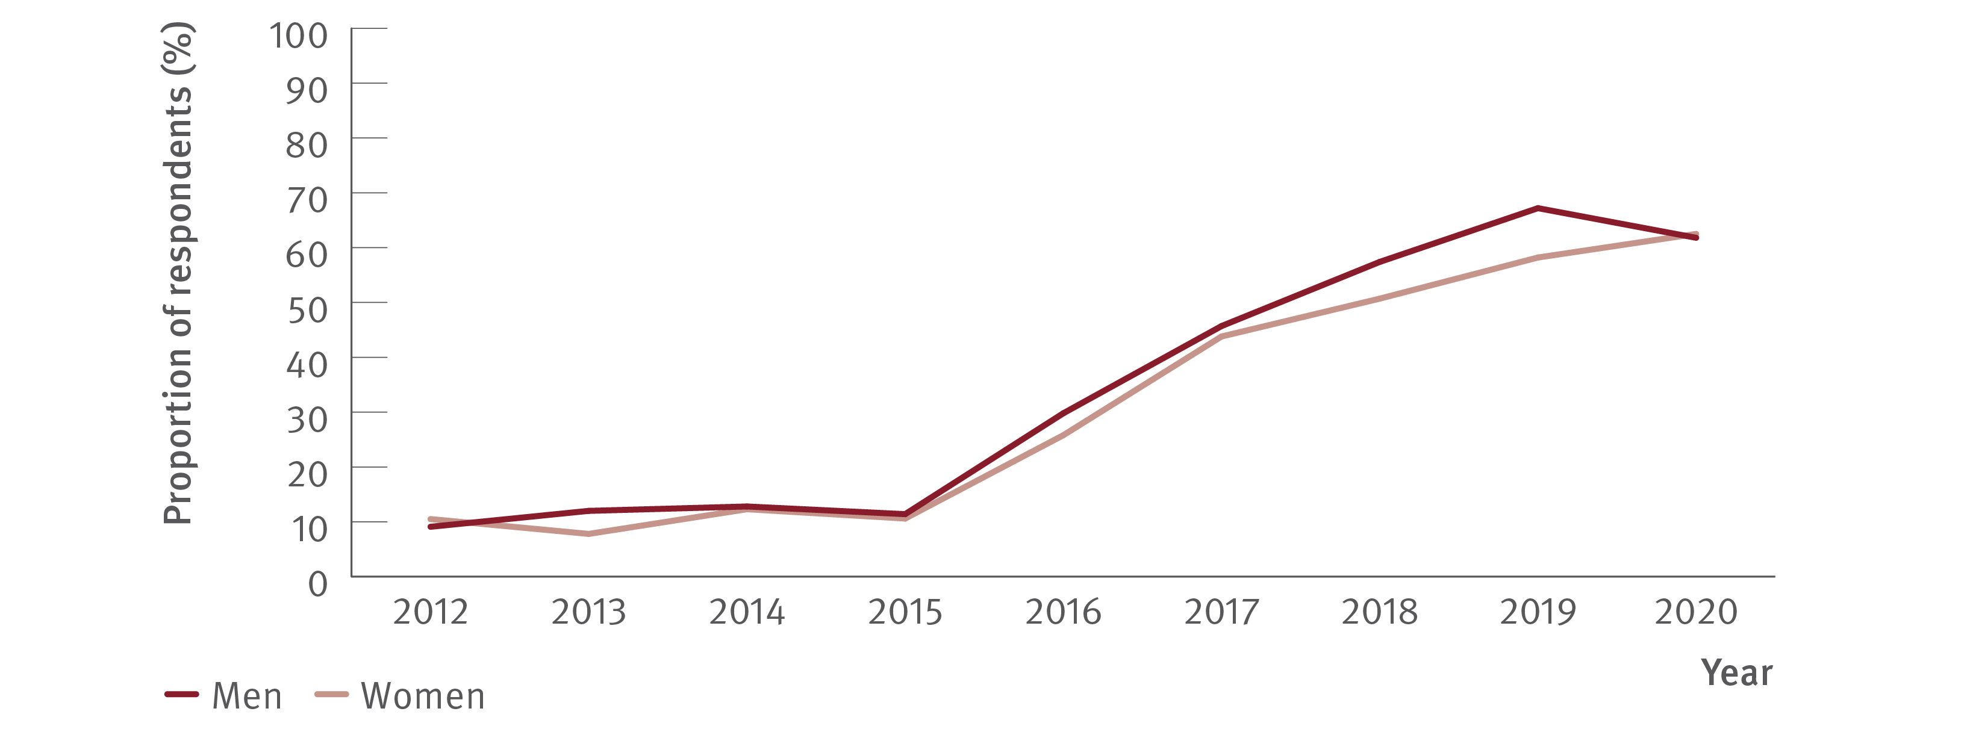
Figure 24. Proportion of ANSPS respondents who tested HCV antibody positive, self‑reporting lifetime history of hepatitis C treatment by gender, 2012–2020
Uptake of treatment
Source: Australian Needle Syringe Program Survey. National Data Report 2016–2020.⁽¹⁸⁾
Notes:
Notes: Includes respondents who tested HCV antibody positive and excludes those self‑reporting spontaneous HCV clearance. No participant recruitment occurred in VIC in 2020.

Slide 33
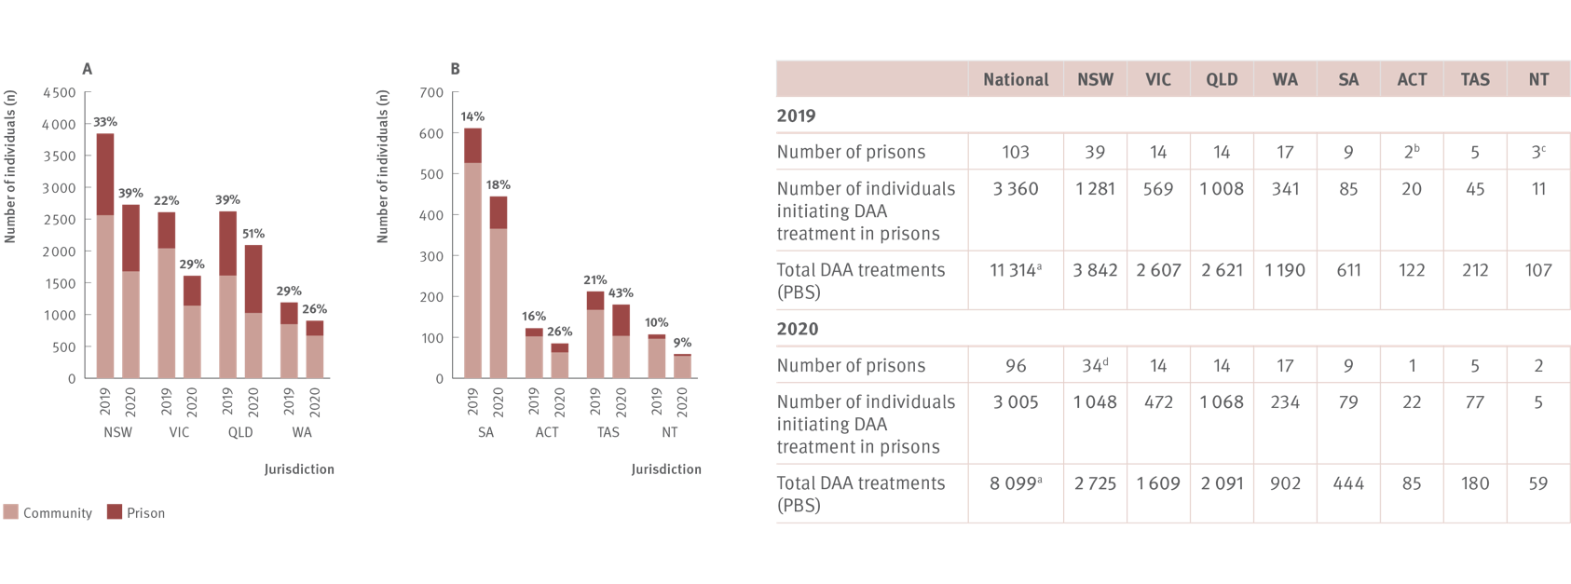
Figure 25. Number and estimated proportion* of individuals who initiated DAA treatment in prison versus in the community by jurisdiction, 2019 and 2020
Uptake of treatment
Sources: State and Territory justice health authorities via the National Prisons Hepatitis Network.⁽²⁶⁾ Monitoring treatment uptake in Australia.^{(2,25)}
Notes:
Notes: *The proportion of all treatments that were initiated in prisons was estimated using the actual number of treatments reported by jurisdictional hepatitis services as a proportion of all treatments derived from the PBS database. PBS treatment numbers may vary from previous or future reports due to refinements made to PBS data between releases (2019 and 2020 data from 2021 release of data). ªNational total includes DAA treatment initiations with unknown jurisdictions; therefore the national total treatments will not add to the sum of the jurisdictional totals. ^{b}One prison and one mental health correctional facility; ^{c}Two prisons and one youth detention; ^{d} Between 2019 and 2020, five prisons closed. Data were collected from 31 public prisons (January–December) and one private prison (January–June 2020), data were not collected from two private prisons.

Slide 34
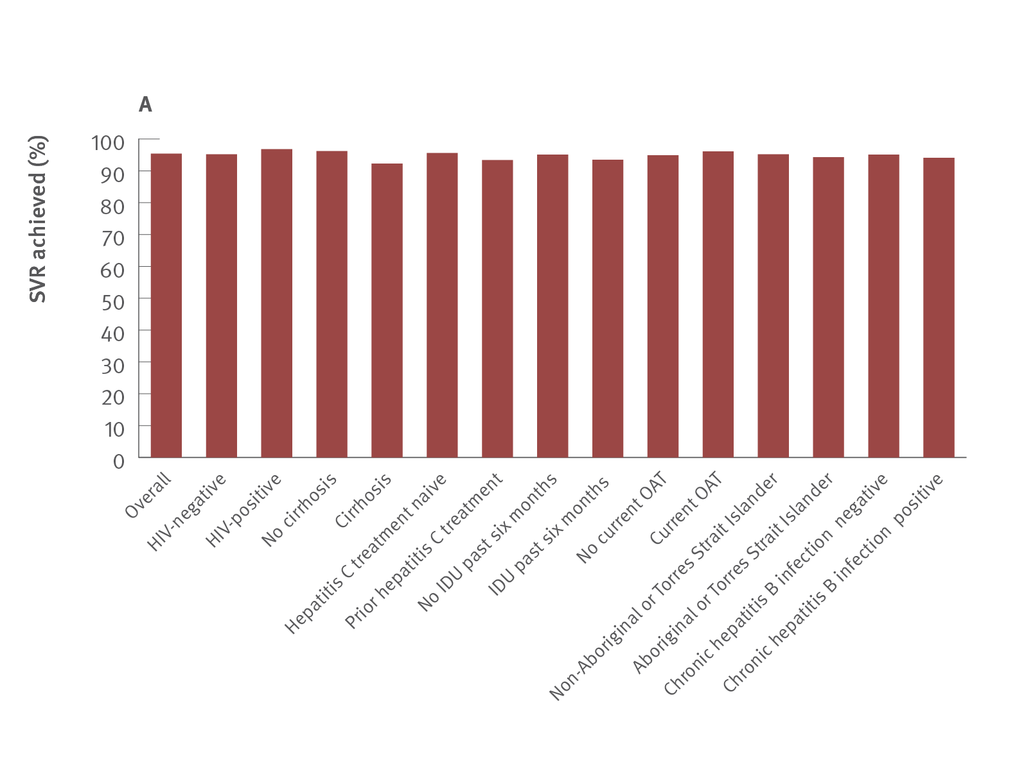
Figure 26. Proportion of individuals with SVR by clinical characteristics (A) and treatment setting (B) in the per protocol population, REACH‑C, March 2016–October 2020
Uptake of treatment
Source: REACH‑C.^{(13,14,15)}
Notes:
Notes: Per protocol population was individuals with a known HCV RNA test result 12 weeks post‑treatment by October 2020. ‘Chronic hepatitis B infection positive’ defined as hepatitis B surface antigen positive. *‘Other’ includes Aboriginal health service, mental health, and outreach. Treatment outcome was unknown in 14.6% (1 584/10 843) of individuals (1 584/10 843) and of these 4.9% (79/1 584) had died prior to SVR12. Rates of unknown SVR increased over time: 2016, 8.6% (459/5 337); 2017, 16.5% (514/3 109); 2018, 24.9% (457/1 837); 2019 27.5% (154/560).

Slide 35
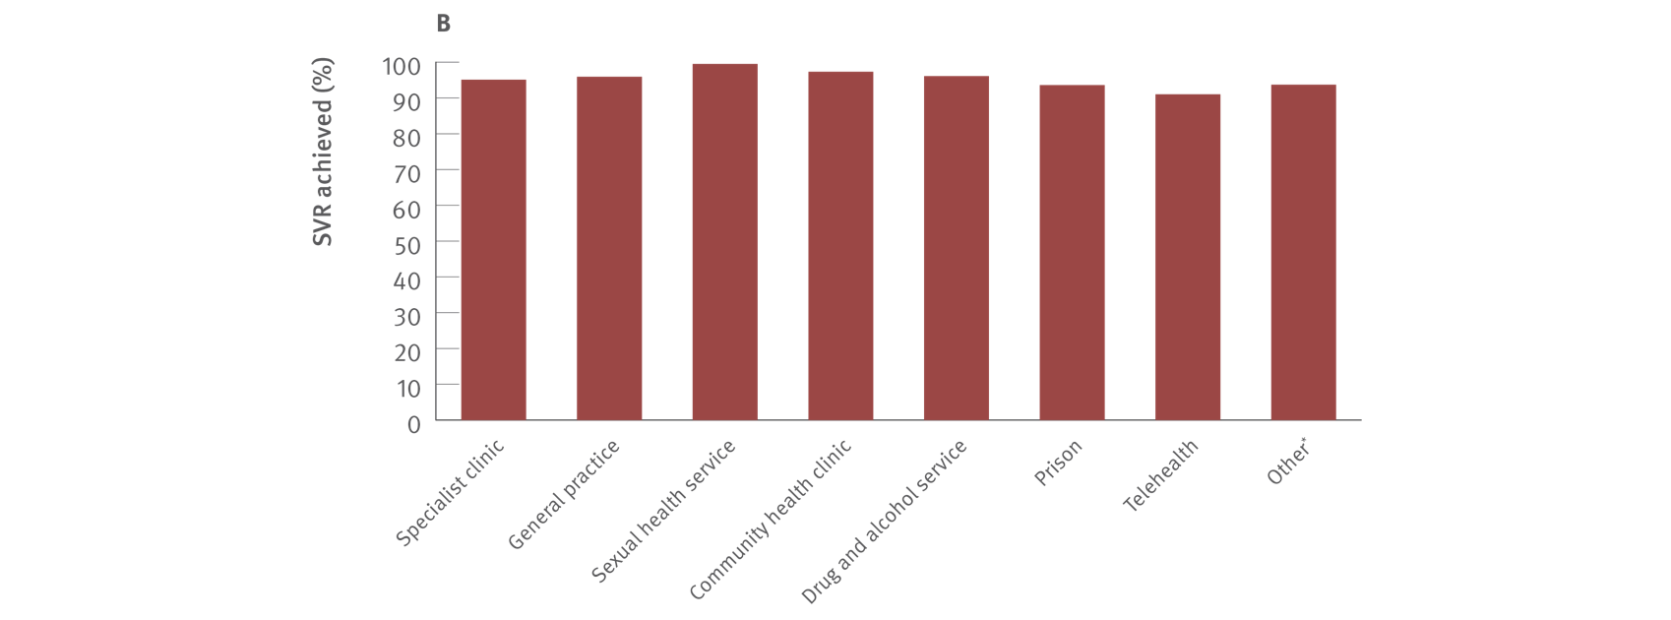
Figure 26. Proportion of individuals with SVR by clinical characteristics (A) and treatment setting (B) in the per protocol population, REACH‑C, March 2016–October 2020
Uptake of treatment
Source: REACH‑C.^{(13,14,15)}
Notes:
Notes: Per protocol population was individuals with a known HCV RNA test result 12 weeks post‑treatment by October 2020. ‘Chronic hepatitis B infection positive’ defined as hepatitis B surface antigen positive. *‘Other’ includes Aboriginal health service, mental health, and outreach. Treatment outcome was unknown in 14.6% (1 584/10 843) of individuals (1 584/10 843) and of these 4.9% (79/1 584) had died prior to SVR12. Rates of unknown SVR increased over time: 2016, 8.6% (459/5 337); 2017, 16.5% (514/3 109); 2018, 24.9% (457/1 837); 2019 27.5% (154/560).

Slide 36
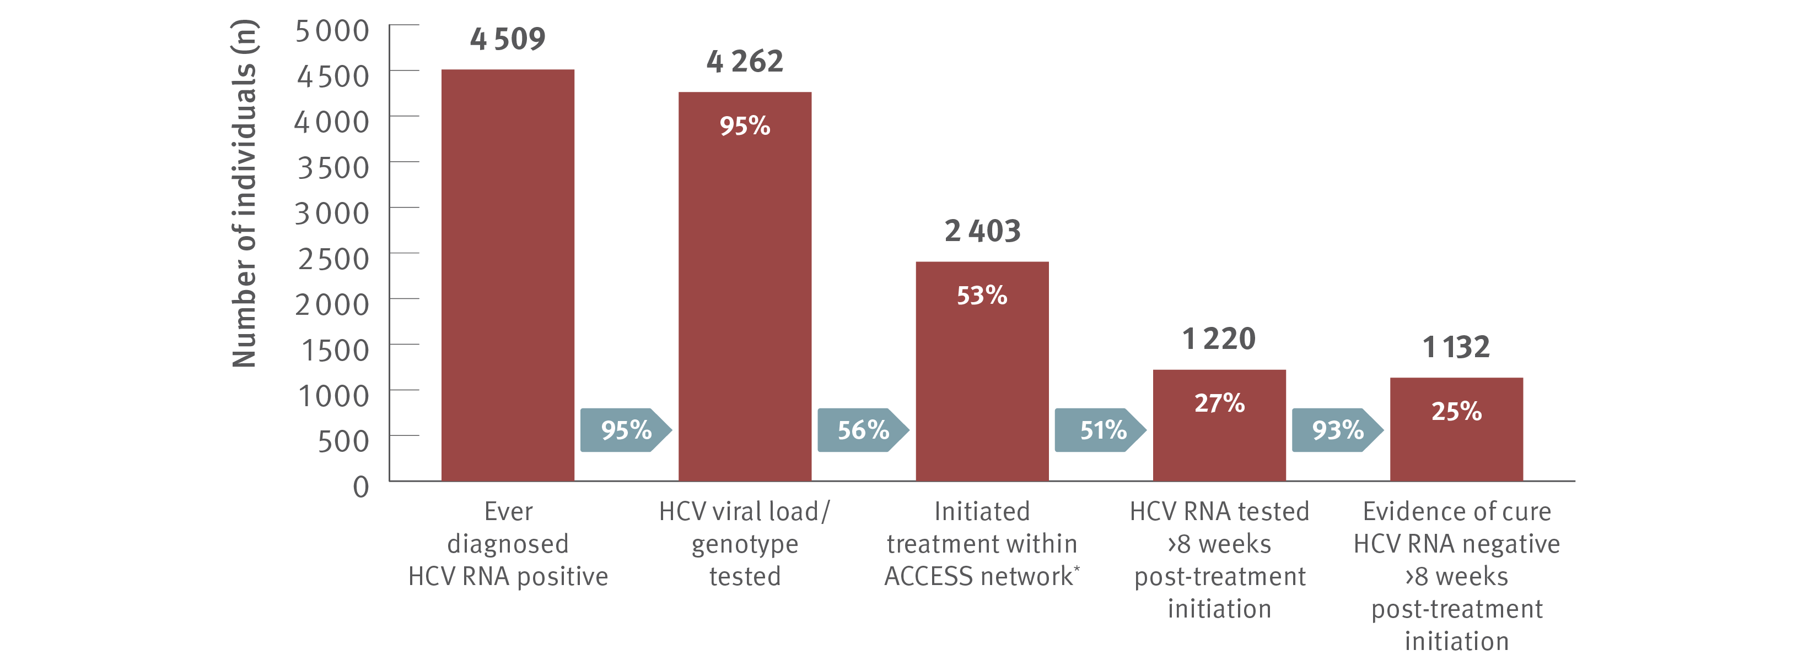
Figure 27. Hepatitis C treatment cascade at ACCESS primary care clinics: number of individuals hepatitis C diagnosed, number and proportion of individuals who initiated treatment, and tested for HCV RNA post‑treatment initiation, 2016–2020
Uptake of treatment
Source: ACCESS.⁽⁹⁾ Updated from Traeger et al., PLOS One 2020.⁽²⁸⁾
Notes:
Notes: Cascade includes individuals with evidence of ever being diagnosed HCV RNA positive, i.e., a positive HCV RNA test result recorded in ACCESS since 2009. The cascade reflects the status of individuals at 31st December 2020 and is restricted to individuals who had a clinical consultation within the five years prior (2016–2020). Includes individuals attending ACCESS primary care clinics (same primary care clinics as other ACCESS sections in report). *Treatment initiation is indicated by the presence of an electronic medical record of a prescription of DAA therapy recorded at an ACCESS clinic. Individuals are assumed to have progressed through preceding cascade stages if evidence of reaching a subsequent stage is present.

Slide 37
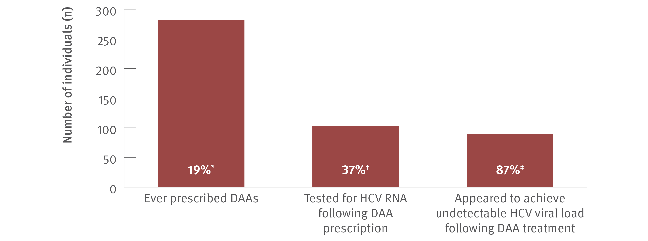
Figure 28. Hepatitis C treatment cascade: number and proportion of individuals attending ACCHSs tested for HCV RNA and prescribed DAAs, and among those treated, the number and proportion who appeared to achieve an undetectable HCV viral load, ATLAS network, aggregated for years 2016–2020
Uptake of treatment
Source: ATLAS sexual health surveillance network, 2016–2020.⁽¹⁷⁾
Notes:
Notes: Individuals defined as people aged 15 years or older, who visited a doctor, nurse, or Aboriginal health practitioner (‘medical consultations’) between 2016 and 2020. ‘Undetectable viral load’ defined as testing negative for HCV RNA or HCV viral load following DAA treatment. A total of 117 549 individuals aged 15 years or older attended medical appointments between 2016 and 2020. *Of individuals who were ever HCV RNA tested, 18.7% (282/1 507) were prescribed DAA treatment. †Of those prescribed DAAs, 36.5% (103/282) had an HCV RNA test following treatment, of whom ‡87.4% (90/103) had an undetectable HCV viral load and 12.6% (13/103) were either positive or not tested (data unavailable to define these 13 further).

Slide 38
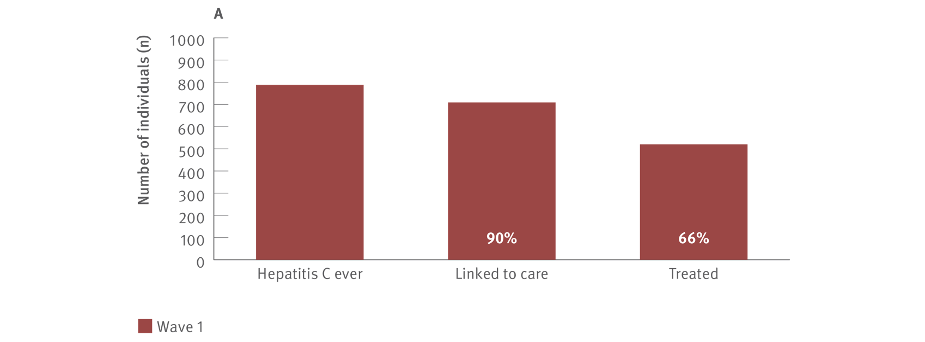
Figure 29. Number of individuals and proportion enrolled in ETHOS Engage that were ever hepatitis C infected, linked to care, and treated, A: Wave 1 (May 2018–September 2019) and B: Wave 2 (November 2019–June 2021)
Uptake of treatment
Source ETHOS Engage study.⁽²⁰⁾ Wave 2 data, ETHOS Engage study, unpublished data.
Notes:
Notes: HCV ever determined by a combination of results obtained from point‑of‑care HCV RNA testing and self‑reported hepatitis C status. Linked to care was defined as those who had ever been to a doctor or specialist to discuss their hepatitis C, had ever received a fibroscan after diagnosis, or had ever received hepatitis C treatment. Of those diagnosed with hepatitis C, determined by a combination of self‑report (previous hepatitis C treatment) and point‑of‑care HCV RNA testing for detection of current infection: Wave 1, 87.1% (686/788) were linked to care and 66.0% (520/788) were treated; Wave 2, 83.5% (510/611) were linked to care and 77.9% (476/611) were treated. In Wave 1, treatment uptake was positively associated with being male, aged 45 years (median participant age) or older, and currently receiving OAT. In Wave 2, treatment uptake was positively associated with being aged 45 years (median participant age) or older and ever receiving OAT (past and current). Although treatment uptake was less likely among those who were homeless and with higher injecting frequency (daily or more), in Wave 1 uptake was greater than 47.6% in almost all subpopulations and uptake was greater than 61.8% in Wave 2 in all subpopulations.

Slide 39
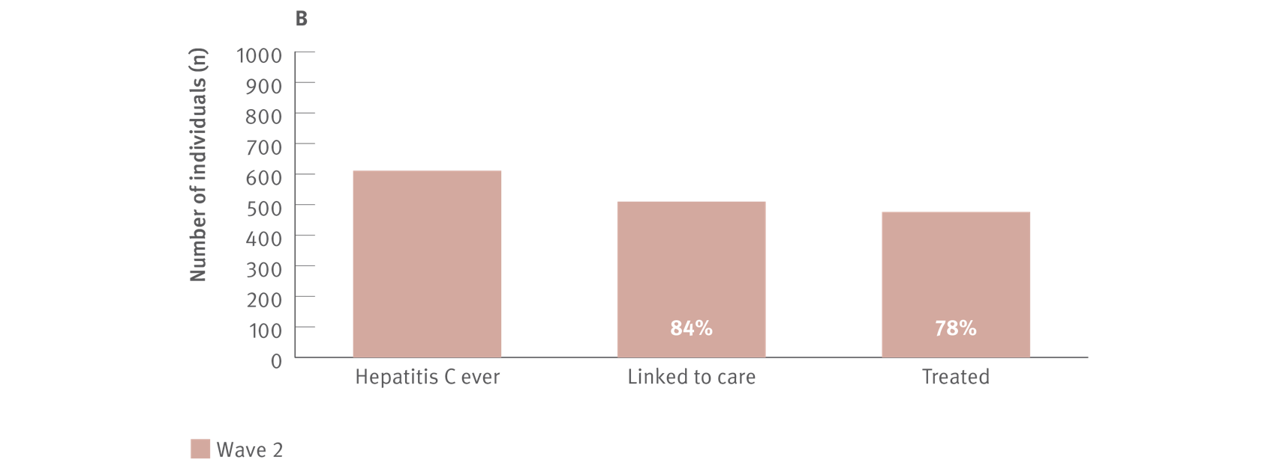
Figure 29. Number of individuals and proportion enrolled in ETHOS Engage that were ever hepatitis C infected, linked to care, and treated, A: Wave 1 (May 2018–September 2019) and B: Wave 2 (November 2019–June 2021)
Uptake of treatment
Source ETHOS Engage study.⁽²⁰⁾ Wave 2 data, ETHOS Engage study, unpublished data.
Notes:
Notes: HCV ever determined by a combination of results obtained from point‑of‑care HCV RNA testing and self‑reported hepatitis C status. Linked to care was defined as those who had ever been to a doctor or specialist to discuss their hepatitis C, had ever received a fibroscan after diagnosis, or had ever received hepatitis C treatment. Of those diagnosed with hepatitis C, determined by a combination of self‑report (previous hepatitis C treatment) and point‑of‑care HCV RNA testing for detection of current infection: Wave 1, 87.1% (686/788) were linked to care and 66.0% (520/788) were treated; Wave 2, 83.5% (510/611) were linked to care and 77.9% (476/611) were treated. In Wave 1, treatment uptake was positively associated with being male, aged 45 years (median participant age) or older, and currently receiving OAT. In Wave 2, treatment uptake was positively associated with being aged 45 years (median participant age) or older and ever receiving OAT (past and current). Although treatment uptake was less likely among those who were homeless and with higher injecting frequency (daily or more), in Wave 1 uptake was greater than 47.6% in almost all subpopulations and uptake was greater than 61.8% in Wave 2 in all subpopulations.

Slide 40
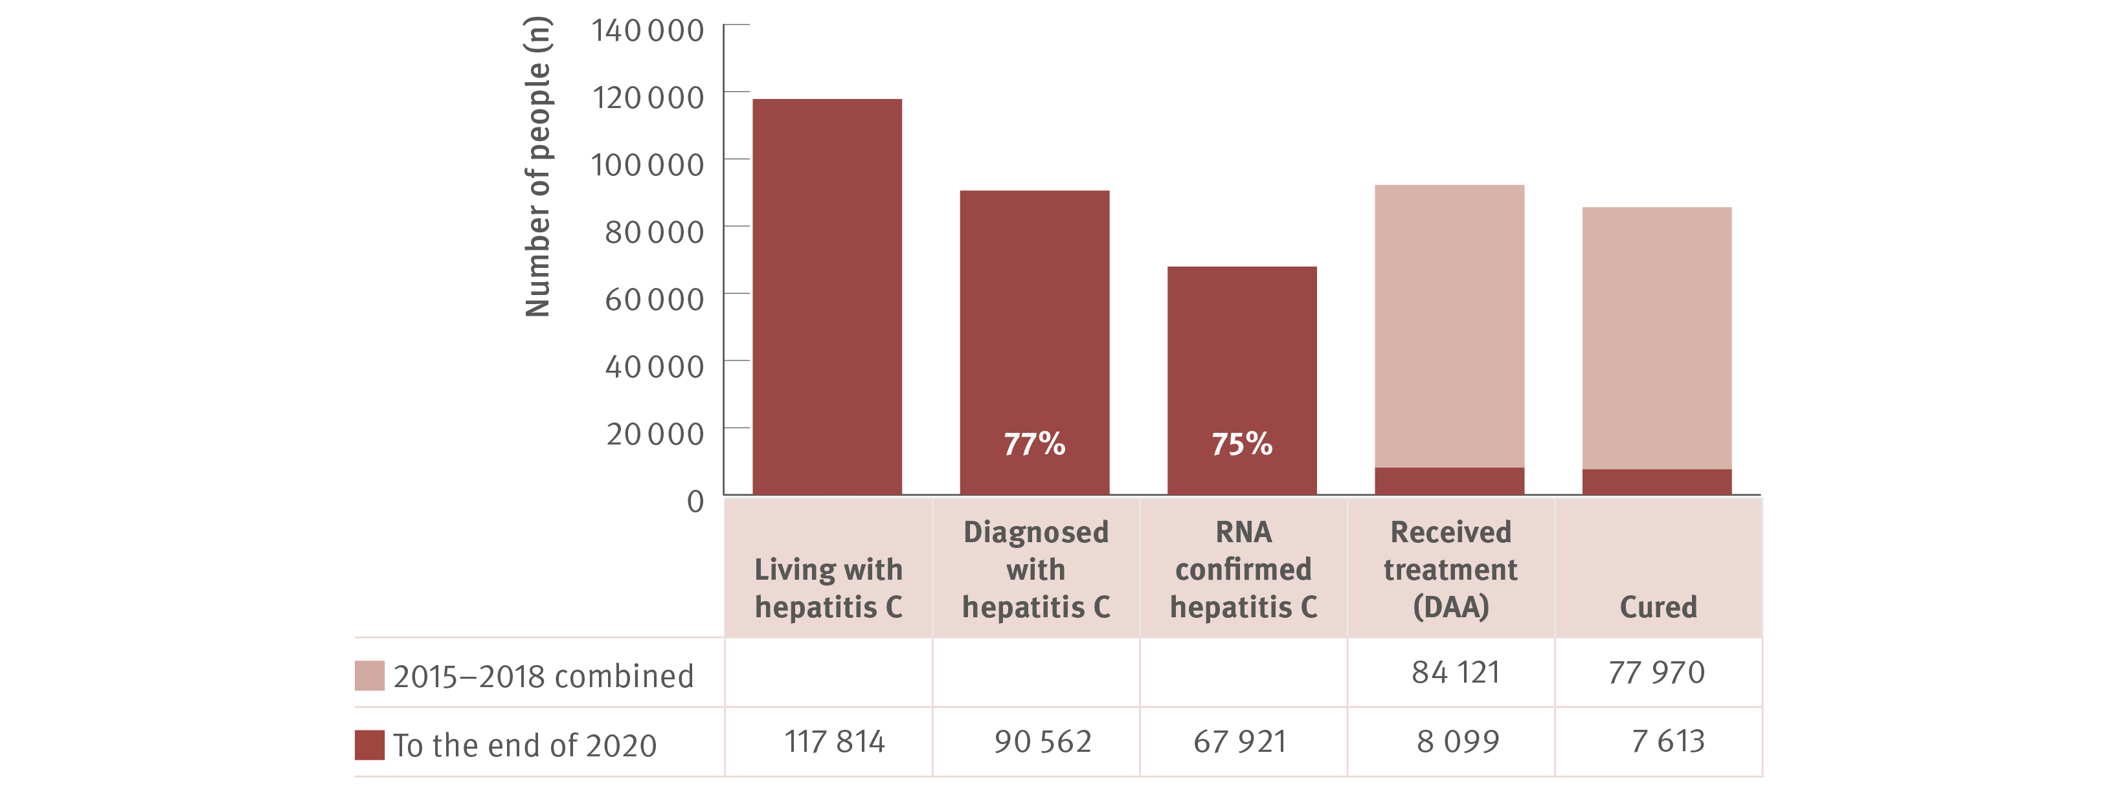
Figure 30. The hepatitis C diagnosis and care cascade, 2020
Uptake of treatment
Source: Updated by Kirby Institute; National update on HIV, viral hepatitis and sexually transmissible infections in Australia: 2009–2018.^{(4,5,18)}
Notes:
Notes: The number of people diagnosed is the estimated number diagnosed at the end 2020, whereas the estimated number treated is the cumulative number since 2015 (n=92 220) and cured is the cumulatively cured since 2015 (n=85 583) to the end of 2020.

Slide 41
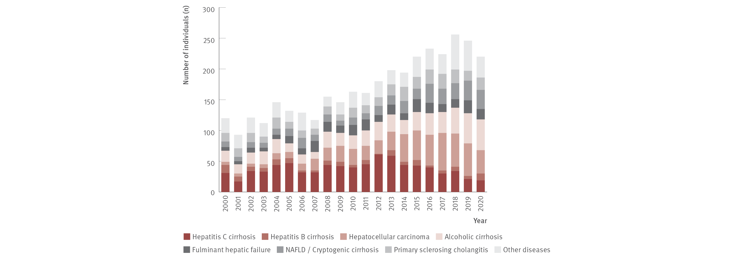
Figure 31. Number of Australian adult liver transplant recipients by primary diagnosis and year of first transplant, 2001–2020
Morbidity
Source: Australia and New Zealand Liver and Intestinal Transplant Registry.⁽³⁰⁾
Notes:
Notes: Australian transplant recipients only. Adults defined as 16 years or older. NAFLD: non‑alcoholic fatty liver disease.

Slide 42
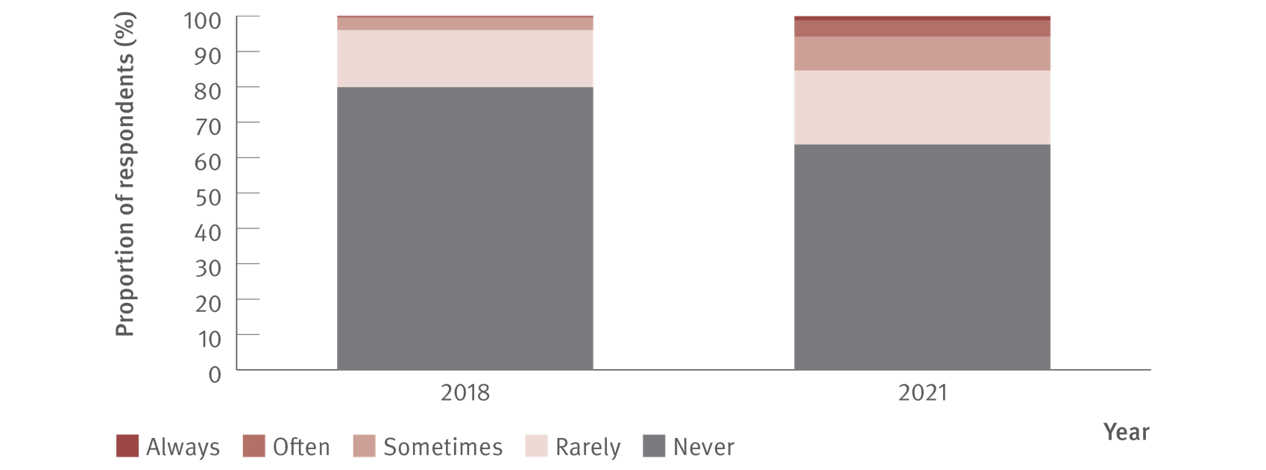
Figure 32. Reports of stigma or discrimination by health care workers towards other people because of their hepatitis C status, 2018 and 2021
Stigma and discrimination
Source: Stigma Indicators Monitoring Project.⁽³¹⁾ 2021 data Stigma Indicators Monitoring Project, unpublished data.
Notes:
Notes: Different recruitment methods were used between 2018 and 2021, therefore, comparisons between time points should be made cautiously.

Slide 43
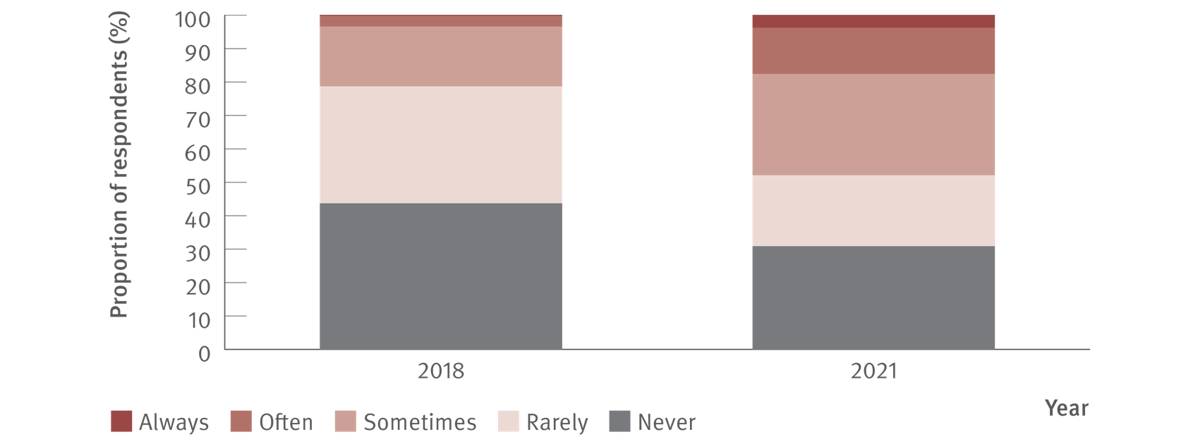
Figure 33. Reports of stigma or discrimination by health care workers towards other people because of their IDU, 2018 and 2021
Stigma and discrimination
Source: Stigma Indicators Monitoring Project.⁽³¹⁾ 2021 data Stigma Indicators Monitoring Project, unpublished data.
Notes:
Notes: Different recruitment methods were used between 2018 and 2021, therefore, comparisons between time points should be made cautiously.

Slide 44
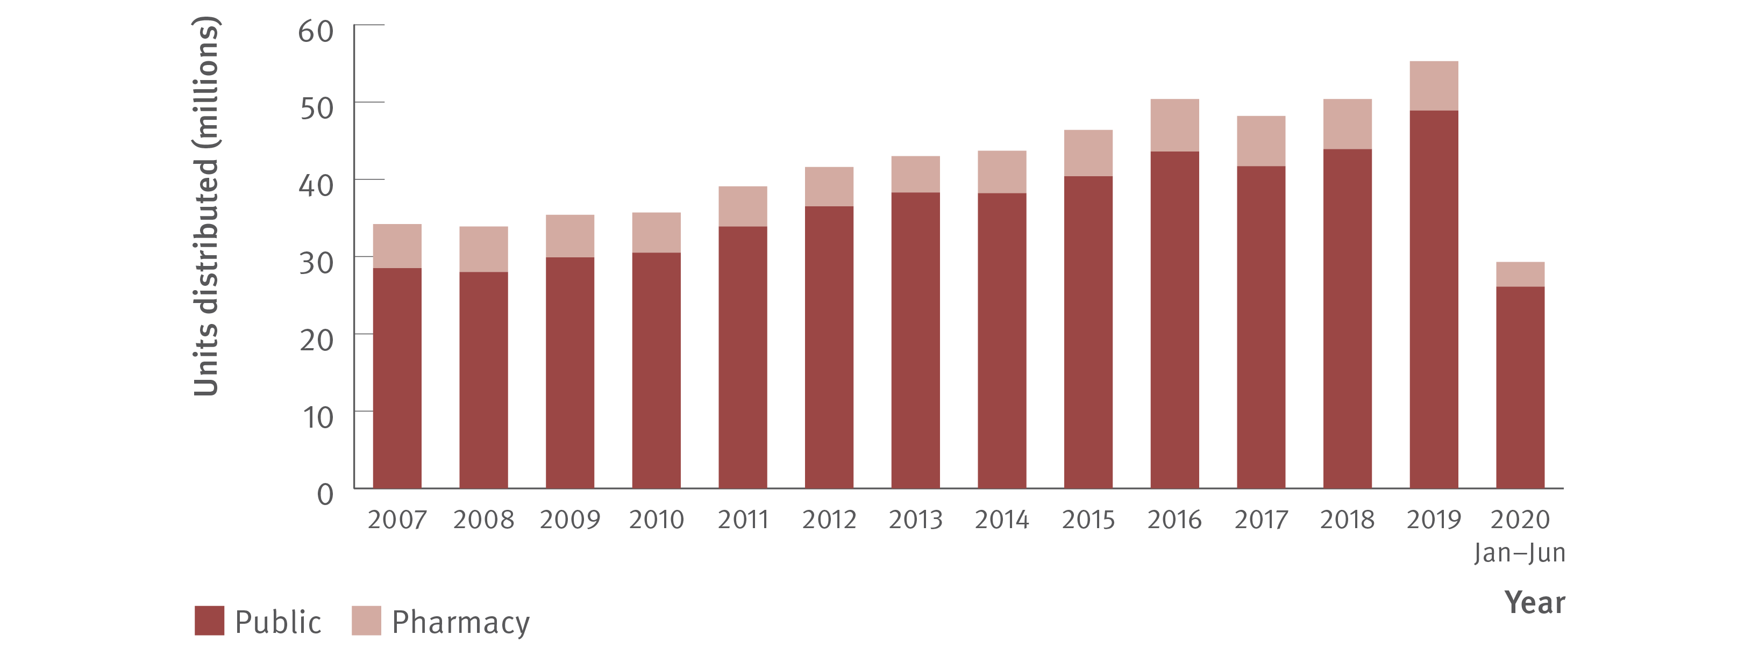
Figure 34. Number of needle and syringe units distributed by public and pharmacy sector, 2007–June 2020
Prevention
Source: Needle Syringe Program National Minimum Data Collection. National Data Report 2020.⁽³³⁾
Notes:
Notes: July–December 2020 data not available at the time of reporting.

Slide 45
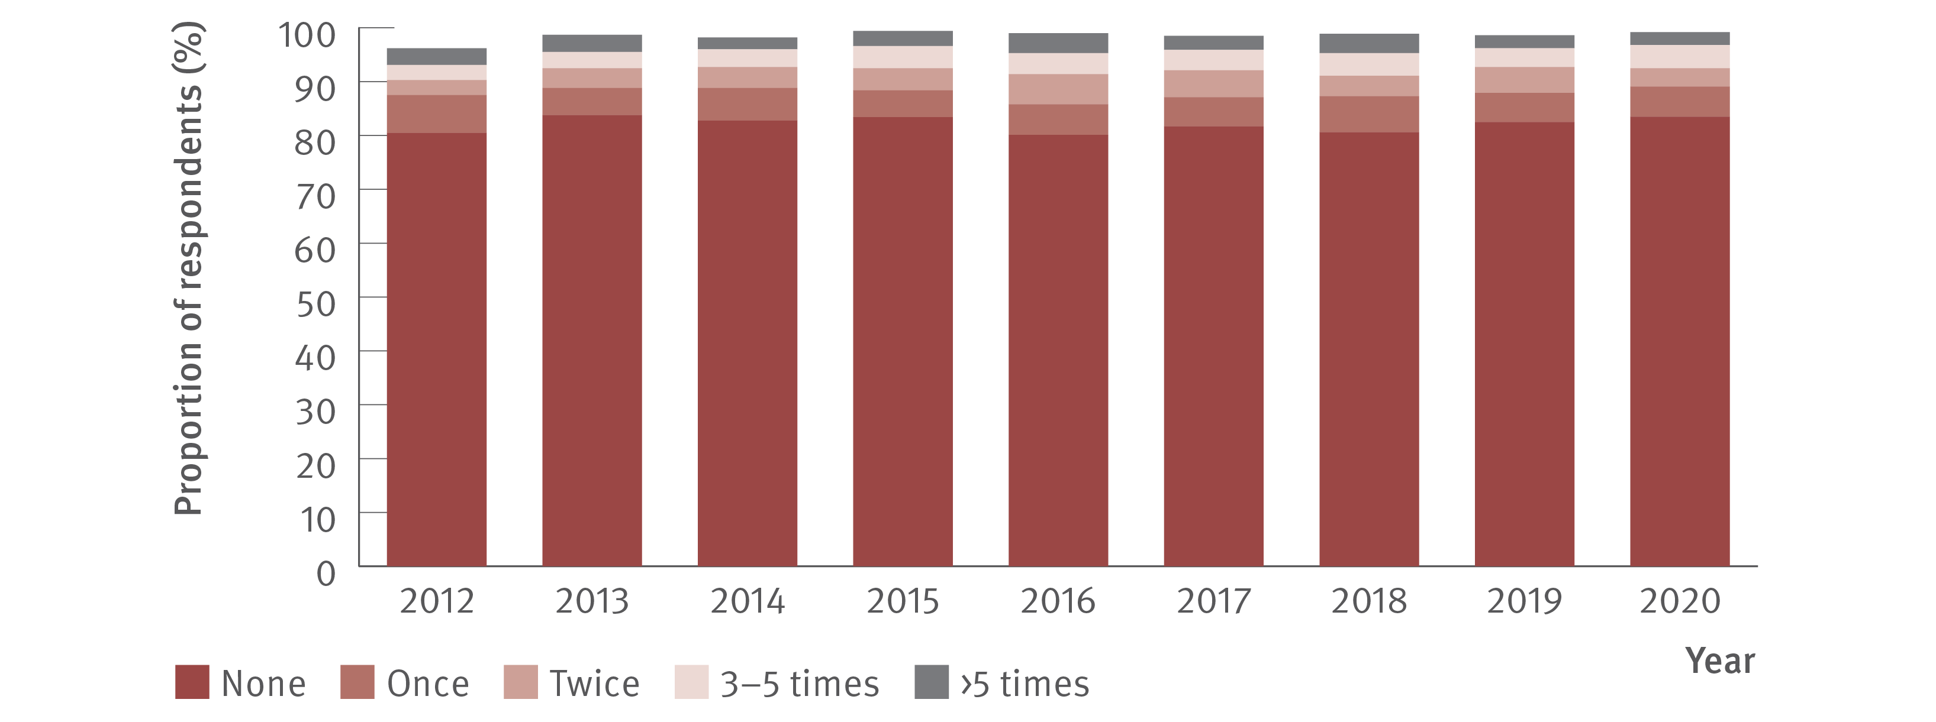
Figure 35. Proportion of respondents reporting re‑use of someone else’s needles and syringes in the past month, 2012–2020
Prevention
Source: Australian Needle Syringe Program Survey. National Data Report 2016–2020.⁽¹⁸⁾
Notes:
Notes: Not reported not included. Injection risk behaviour variables are presented among those who injected in the past month, not the entire sample. For 2012–2020, sample size was (in order): 2 127, 2 111, 2 141, 2 071, 1 993, 2 314, 2 452, 2 333, and 1 173.

Slide 46
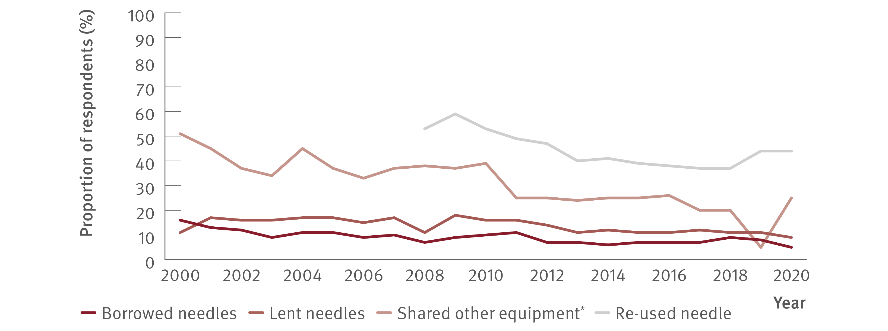
Figure 36. Proportion of respondents reporting borrowing and lending of needles, sharing of injecting equipment, and re‑use of needles in the past month, national, 2000–2020
Prevention
Source: Australian Drug Trends 2020. Key findings from the National Illicit Drug Reporting System (IDRS) Interviews.⁽³⁴⁾
Notes:
Notes: Collection of data about re‑use of needles began in 2008. *Includes spoons, water, tourniquets, and filters.

Slide 47
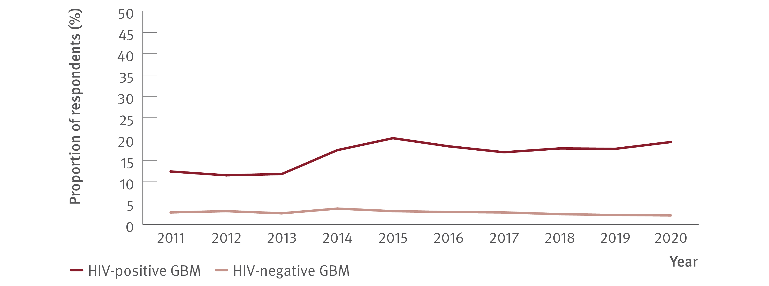
Figure 37. Proportion of GBM who reported any drug injection in the six months prior to the survey by HIV status, national, 2011–2020
Prevention
Source: Gay Community Periodic Survey, Annual Report of Trends in Behaviour 2020: HIV and STIs in Australia.^{(35,36)}
Notes:
Notes: Unadjusted data.

Slide 48
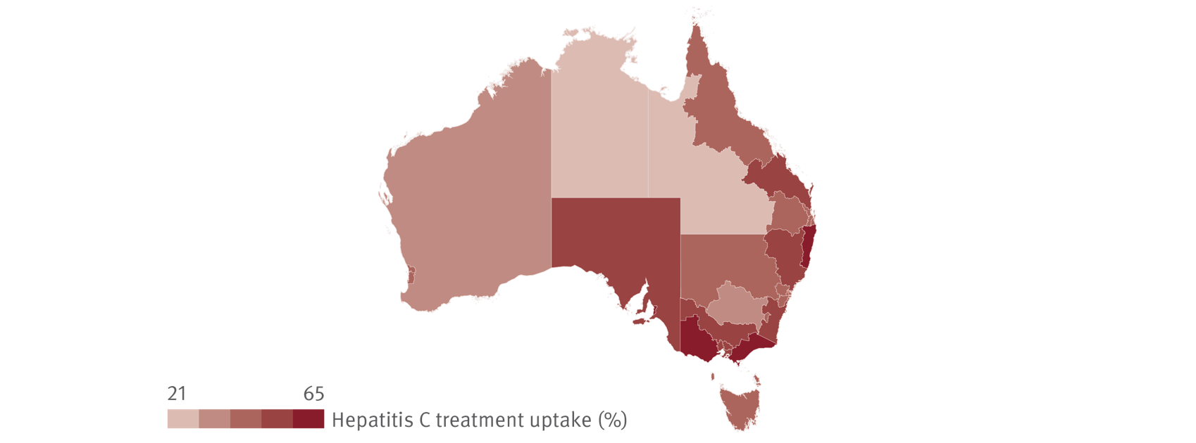
Figure 38. Geographic variation in hepatitis C treatment uptake, March 2016–December 2020
Equity
Source: The National Viral Hepatitis Mapping Project (WHO Collaborating Centre for Viral Hepatitis, The Doherty Institute).⁽²⁷⁾
Notes:
Notes: Hepatitis C prevalence estimates based on mathematical modelling incorporating population‑specific prevalence and Australian Bureau of Statistics population data. Treatment data sourced from Department of Human Services Medicare statistics.

Slide 49
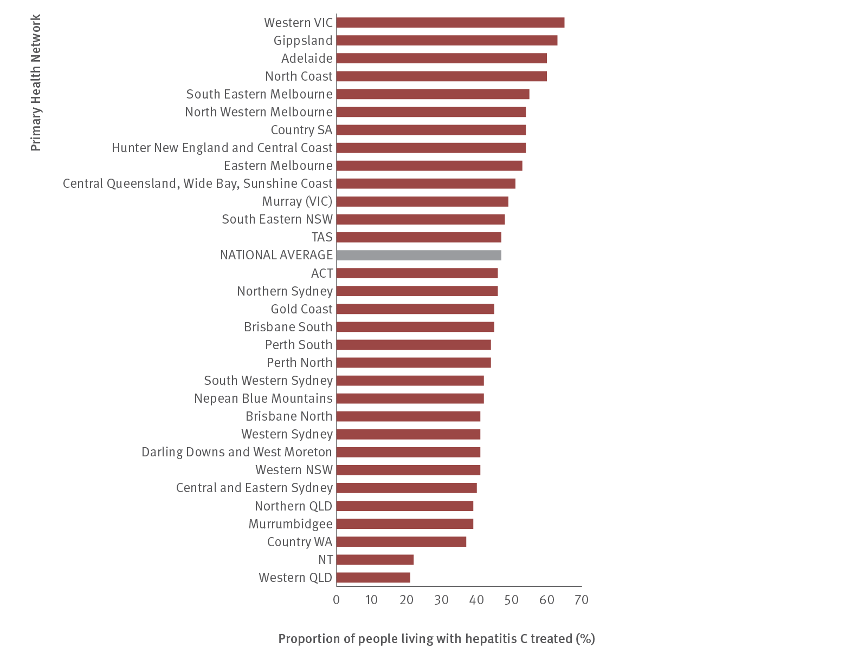
Figure 39. Hepatitis C treatment uptake in Australia by PHN, March 2016–December 2020
Equity
Source: The National Viral Hepatitis Mapping Project (WHO Collaborating Centre for Viral Hepatitis, The Doherty Institute).⁽²⁷⁾
Notes:
Notes: Hepatitis C prevalence estimates based on mathematical modelling incorporating population‑specific prevalence and Australian Bureau of Statistics population data. Treatment data sourced from Department of Human Services Medicare statistics.

Slide 50
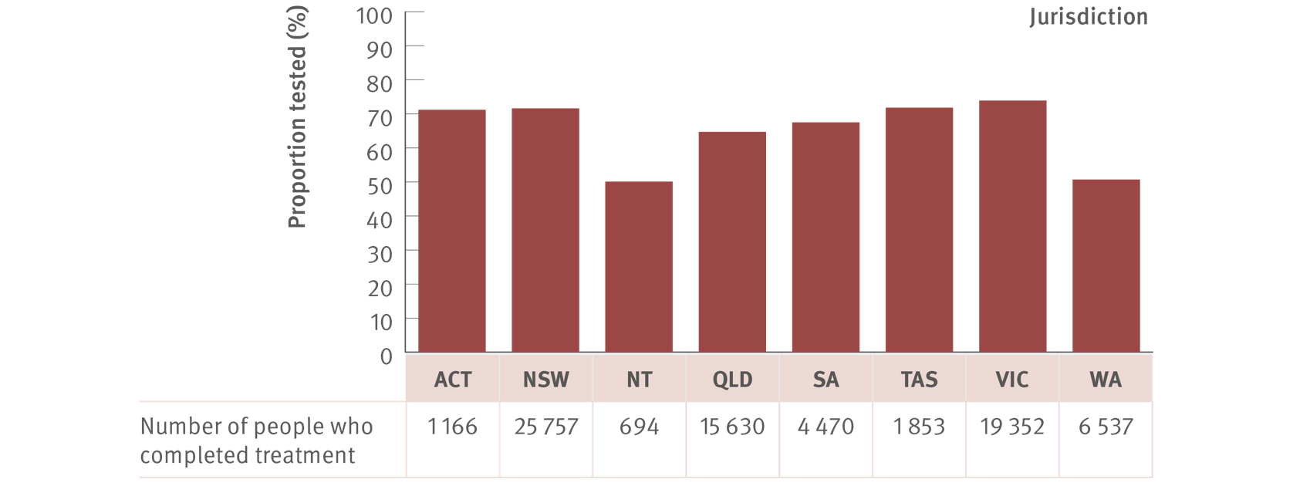
Figure 40. Proportion of individuals that completed treatment and 12 months of follow‑up time, who had an SVR test by jurisdiction, 2016–2020*
Equity
Source: The National Viral Hepatitis Mapping Project (WHO Collaborating Centre for Viral Hepatitis, The Doherty Institute).⁽²⁷⁾
Notes:
Notes: Treatment data sourced from Department of Human Services Medicare statistics. Treatment completion is defined as all scripts collected of the number indicated by the item code used (e.g., three scripts for a 12‑week duration item). *SVR testing data used one year of minimum follow‑up time, restricting measures to those treated between 2016 and 2019.

Slide 51
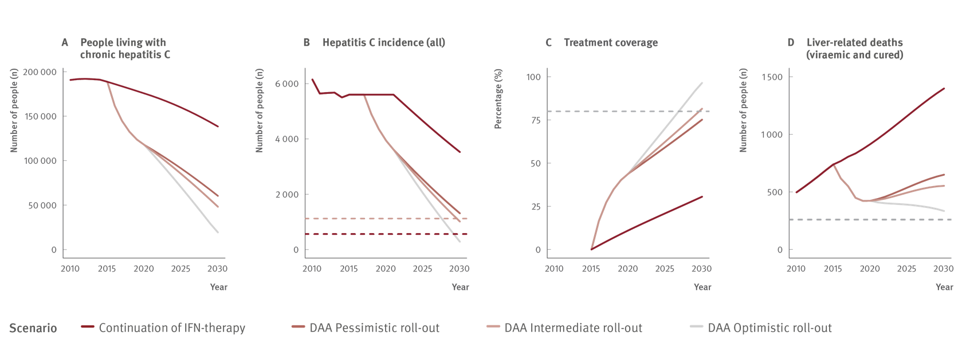
Figure 41. Annual change in people living with chronic hepatitis C, hepatitis C incidence (all), treatment coverage, and liver‑related deaths (viraemic and cured) in Australia 2030 (2010–2030) with WHO HCV elimination targets (dotted lines: Panel B: 80% and 90% reductions in incidence, Panel C: 80% eligible treated, and Panel D: 65% reduction in deaths)
Modelling elimination
Source: Updated from Kwon et al., J. Viral Hepat. 2019.⁽²²⁾

Slide 52
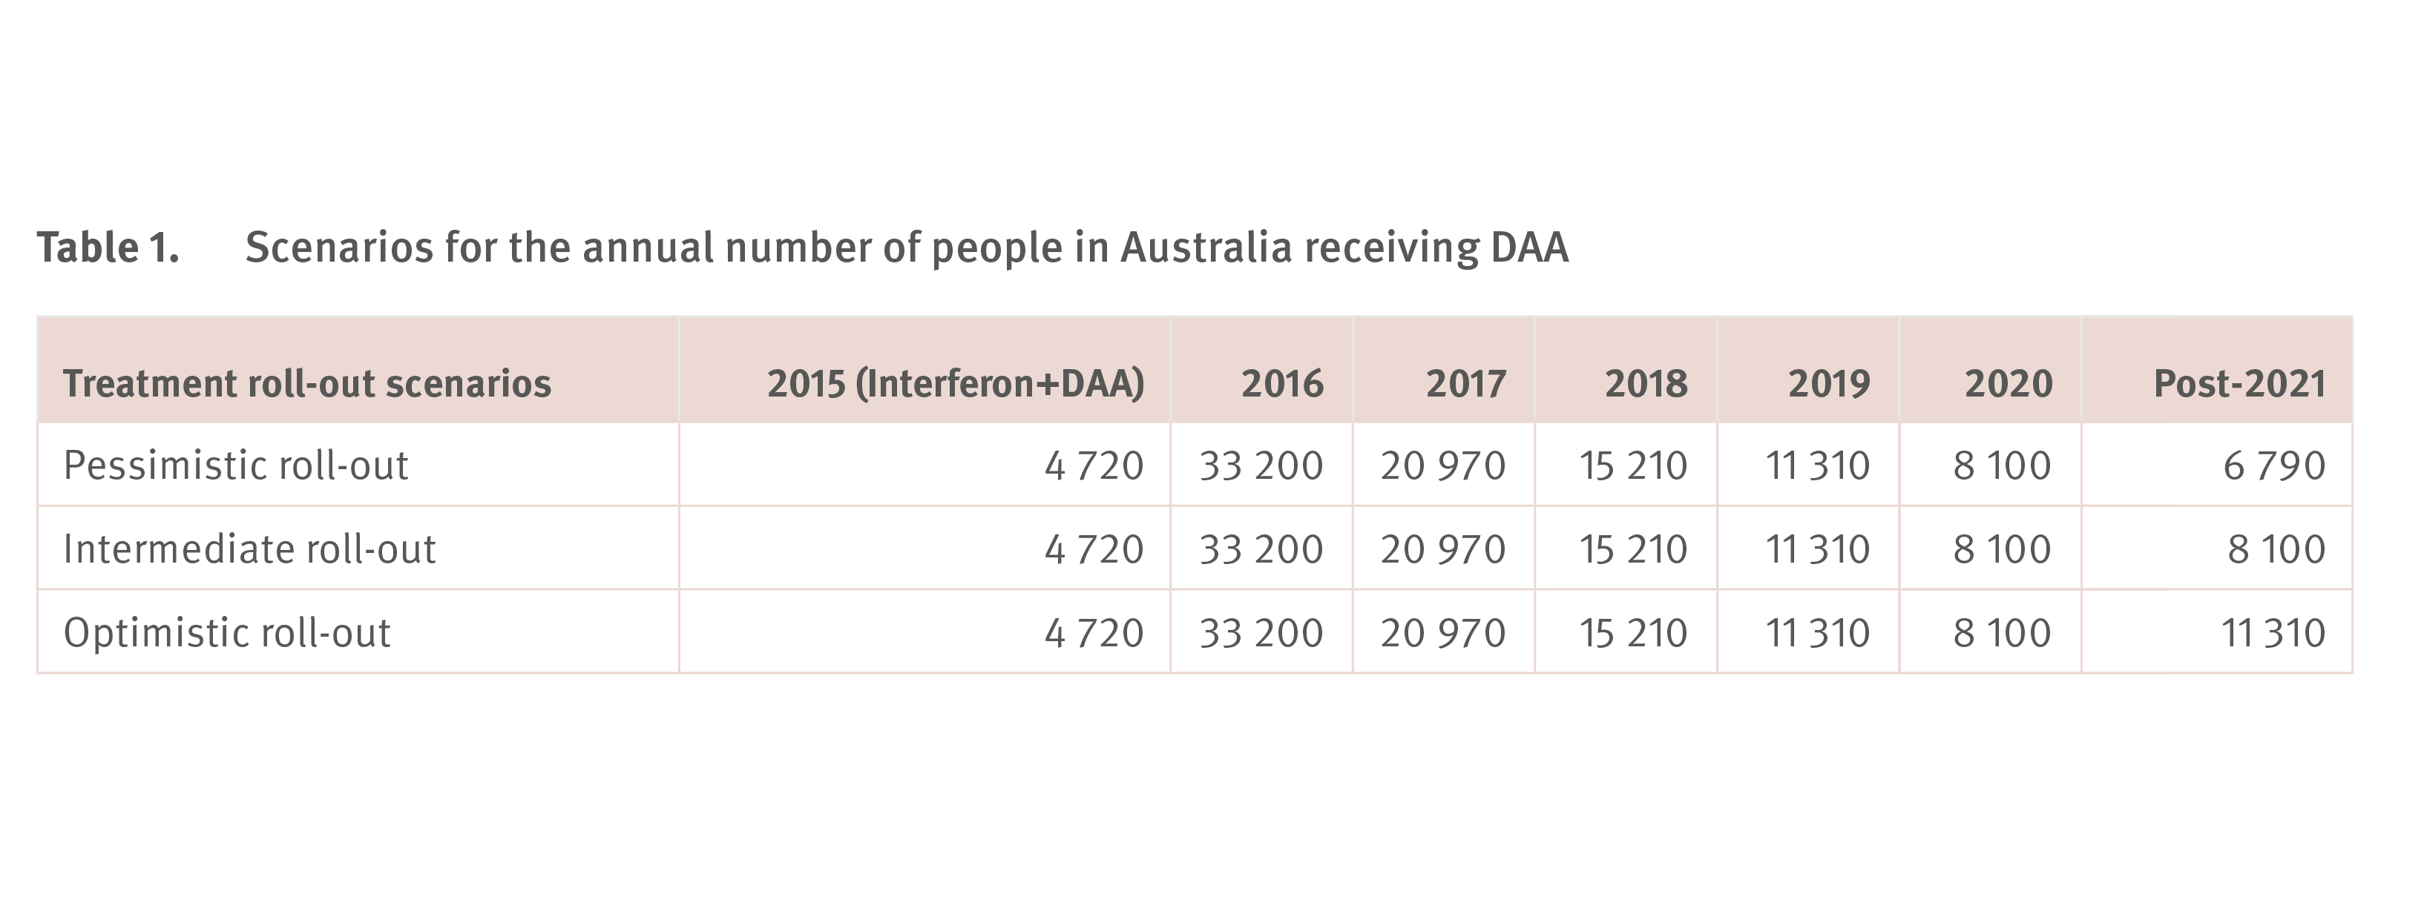
Figure 41. Annual change in people living with chronic hepatitis C, hepatitis C incidence (all), treatment coverage, and liver‑related deaths (viraemic and cured) in Australia 2030 (2010–2030) with WHO HCV elimination targets (dotted lines: Panel B: 80% and 90% reductions in incidence, Panel C: 80% eligible treated, and Panel D: 65% reduction in deaths)
Modelling elimination
Source: Updated from Kwon et al., J. Viral Hepat. 2019.⁽²²⁾

Slide 53
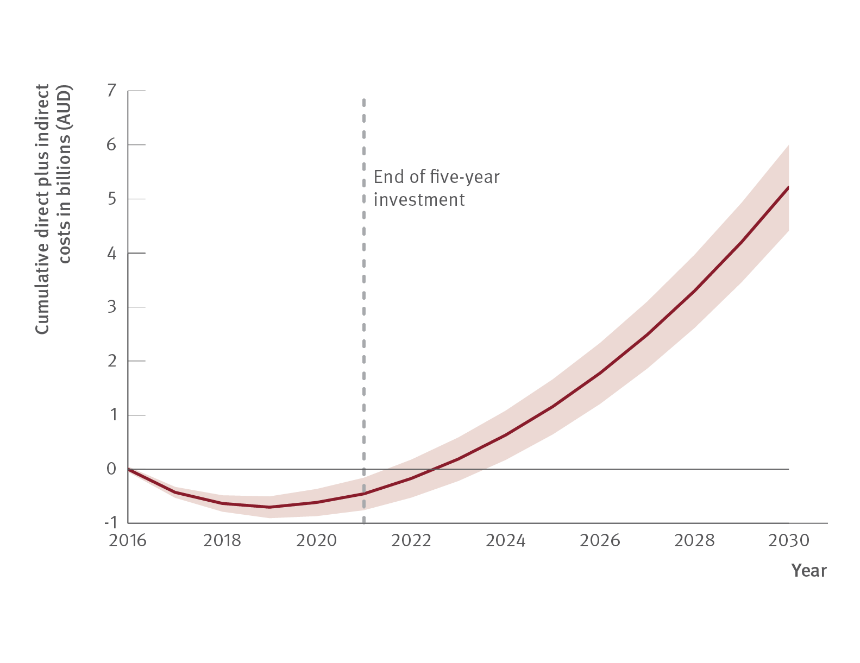
Figure 42. Net economic benefits of hepatitis C treatment scale‑up, based on continued current trends in testing and treatment. The figure shows the difference in cumulative costs (testing, treatment, disease management and productivity losses) between a scenario with no treatment scale‑up, and a scenario with testing/treatment as actually occurred 2016–2021 and trends continued. The initial negative cumulative costs represent the up‑front investment in testing and treatment, before benefits begin to accrue over time
Modelling elimination
Source: Updated from Scott, 12th Australasian Viral Hepatitis Conference 2021.⁽³⁹⁾

Slide 54
Reference list
1. Alavi M, Law MG, Valerio H, et al. Declining hepatitis C virus-related liver disease burden in the direct-acting antiviral therapy era in New South Wales, Australia. J Hepatol. 2019;71(2):281–288. doi:10.1016/j.jhep.2019.04.014. 2. Kirby Institute. Monitoring hepatitis C treatment uptake in Australia (Issue 11). Sydney, Australia: Kirby Institute, UNSW Sydney; 2021. Available at: https://kirby.unsw.edu.au/report/ monitoring-hepatitis-c-treatment-uptake-australia-issue-11-july-2021 (accessed 12th August 2021). 3. Dore GJ, Feld JJ. Hepatitis C virus therapeutic development: in pursuit of “perfectovir”. Clin Infect Dis. 2015;60(12):1829–36. doi:10.1093/cid/civ197. 4. Kirby Institute. National update on HIV, viral hepatitis and sexually transmissible infections in Australia: 2009–2018. Sydney, Australia: Kirby Institute, UNSW Sydney; 2020. Available at: https://kirby.unsw.edu.au/report/national-update-hiv-viral-hepatitis-andsexually- transmissible-infections-australia-2009-2018 (accessed 2nd January 2021). 5. Kwon JA, Dore GJ, Hajarizadeh B, et al. Australia could miss the WHO hepatitis C virus elimination targets due to declining treatment uptake and ongoing burden of advanced liver disease complications. PLoS One. 2021;16(9):e0257369. doi:10.1371/journal.pone.0257369. 6. Australian Government, Department of Health. Fifth National Hepatitis Strategy 2018– 2022. Canberra, Australia: Australian Government, Department of Health; 2018. Available at: https://www.health.gov.au/internet/main/publishing.nsf/Content/ohp-bbvs-1//$File/Hep-CFifth- Nat-Strategy-2018-22.pdf (accessed 13th June 2021). | 7. Australian Government, Department of Health. National Notifiable Disease Surveillance System. Canberra, Australia: Australian Government, Department of Health; 2021. Available at: http://www9.health.gov.au/cda/source/cda-index.cfm (accessed 13th August 2021). 8. O’Keefe D, Horyniak D, Dietze P. From initiating injecting drug use to regular injecting: retrospective survival analysis of injecting progression within a sample of people who inject drugs regularly. Drug Alcohol Depend. 2016;158:177–80. doi:10.1016/j. drugalcdep.2015.11.022. 9. Burnet Institute, Kirby Institute, and National Serology Reference Laboratory. The Australian Collaboration for Coordinated Enhanced Sentinel Surveillance of Sexually Transmisible Infections and Blood Borne Viruses (ACCESS). Melbourne, Australia: Burnet Institute, Kirby Institute, and National Serology Reference Laboratory; 2021. Available at: https://accessproject.org.au/ (accessed 15th May 2021). 10. Callander D, Moreira C, El-Hayek C, et al. Monitoring the control of sexually transmissible infections and blood-borne viruses: protocol for the Australian Collaboration for Coordinated Enhanced Sentinel Surveillance (ACCESS). JMIR Res Protoc. 2018;7(11):e11028. doi:10.2196/11028. 11. Nguyen L, Stoove M, Boyle D, et al. Privacy-preserving record linkage of deidentified records within a public health surveillance system: evaluation study. J Med Internet Res. 2020;22(6):e16757. doi:10.2196/16757. | 12. Hajarizadeh B, Grebely J, Byrne M, et al. Evaluation of hepatitis C treatment-asprevention within Australian prisons (SToP-C): a prospective cohort study. Lancet Gastroenterol Hepatol. 2021;6(7):533–546. doi:10.1016/S2468-1253(21)00077-7. 13. Yee J, Carson J, Hanson J, et al. Real world efficacy of antiviral therapy in chronic hepatitis C in Australia (REACH-C). Sydney, Australia: Kirby Institute, UNSW Sydney; 2020. Available at: https://kirby.unsw.edu.au/project/reach-c (accessed 7th July 2021). 14. Carson JM, Hajarizadeh B, Hanson J, et al. Effectiveness of treatment for hepatitis C virus reinfection following direct acting antiviral therapy in the REACH-C cohort. Int J Drug Policy. 2021; 103422 (online early). doi:10.1016/j.drugpo.2021.103422. Hepatitis C Elimination in Australia 2021 77 15. Yee J, Carson JM, Hajarizadeh B, et al. High effectiveness of broad access direct-acting antiviral therapy for hepatitis C in an Australian real-world cohort: the REACH-C study. Hepatology Communication. 2021; (online early). 16. Australasian Society for HIV, Viral Hepatitis and Sexual Health Medicine (ASHM). National Hepatitis C Testing Policy 2020. Darlinghurst, NSW, Australia: Australasian Society for HIV, Viral Hepatitis and Sexual Health Medicine (ASHM); 2020. Available at: http://testingportal. ashm.org.au/national-hcv-testing-policy/ (accessed 1st June 2021). 17. Bradley C, Hengel B, Crawford K, et al. Establishment of a sentinel surveillance network for sexually transmissible infections and blood borne viruses in Aboriginal primary care services across Australia: the ATLAS project. BMC Health Services Research. 2020;20(769). doi.org/10.1186/s12913-020-05388-y.

Slide 55
Reference list
18. Heard S, Iversen J, Maher L. Australian Needle Syringe Program Survey. National Data Report 2016–2020: Prevalence of HIV, HCV and injecting and sexual behaviour among NSP attendees. Sydney, Australia: Kirby Institute, UNSW Sydney; 2021. Available at: https://kirby. unsw.edu.au/project/australian-needle-and-syringe-program-survey-ansps%20 (accessed 2nd August 2021). 19. Australian Government. Medicare Australia Statistics. Canberra, Australia: Australian Government, Department of Human Services; 2021. Available at: http://medicarestatistics. humanservices.gov.au/statistics/mbs_item.jsp (accessed 25th July 2021). 20. Valerio H, Alavi M, Silk D, et al. Progress towards elimination of hepatitis C infection among people who inject drugs in Australia: the ETHOS Engage Study. Clin Infect Dis. 2020;73(1):e69–e78. doi:10.1093/cid/ciaa571. 21. Scott N, Sacks-Davis R, Wade AJ, et al. Australia needs to increase testing to achieve hepatitis C elimination. Med J Aust. 2020;212(8):365–370. doi:10.5694/mja2.50544. 22. Kwon JA, Dore GJ, Grebely J, et al. Australia on track to achieve WHO HCV elimination targets following rapid initial DAA treatment uptake: a modelling study. J. Viral Hepat. 2019;26(1):83-92. doi:10.1111/jvh.13013. 23. Martin NK, Thornton A, Hickman M, et al. Can Hepatitis C Virus (HCV) direct-acting antiviral treatment as prevention reverse the HCV epidemic among men who have sex with men in the United Kingdom? Epidemiological and modeling insights. Clin Infect Dis. 2016;62(9):1072-1080. doi:10.1093/cid/ciw075. | 24. Scott N, McBryde ES, Thompson A, et al. Treatment scale-up to achieve global HCV incidence and mortality elimination targets: a cost-effectiveness model. Gut. 2017;66(8):1507–1515. doi:10.1136/gutjnl-2016-311504. 25. Stafford F, Dore GJ, Clackett S, et al. Prescribing of direct-acting antiviral therapy by general practitioners for people with hepatitis C in an unrestricted treatment program. Med J Aust. 2021; (online early). doi:10.5694/mja2.51204. 26. National Prisons Hepatitis Network. Sydney, Australia: Kirby Institute, UNSW Sydney; 2021. Available at: https://www.nphn.net.au/about (accessed 5th March 2021). 27. MacLachlan J, Smith C, Towell T, et al. Viral Hepatitis Mapping Project: National Report 2019–2020. Darlinghurst, NSW, Australia: Australasian Society for HIV, Viral Hepatitis and Sexual Health Medicine (ASHM); 2021. Available at: https://ashm.org.au/programs/Viral- Hepatitis-Mapping-Project/ (accessed 15th October 2021). 28. Traeger MW, Pedrana AE, van Santen DK, et al. The impact of universal access to directacting antiviral therapy on the hepatitis C cascade of care among individuals attending primary and community health services. PLoS One. 2020;15(6):e0235445. doi:10.1371/ journal.pone.0235445. 29. Butler T, Simpson M. National prison entrant’s blood-borne virus survey report 2004, 2007, 2010, 2013 and 2016. Sydney, Australia: Kirby Institute, UNSW Sydney; 2017. Available at: https://kirby.unsw.edu.au/report/national-prison-entrants-bloodborne-virus-and-riskbehaviour- survey-report-2004-2007-2010 (accessed 22nd August 2021). 78 Hepatitis C Elimination in Australia 2021 | 30. Australia and New Zealand Liver and Intestinal Transplant Registry. Melbourne, Australia: Austin Hospital; 2021. Available at: https://www.anzlitr.org/ (accessed 15th June 2021). 31. Broady TR, Cama E, Brener L, et al. Responding to a national policy need: development of a stigma indicator for bloodborne viruses and sexually transmissible infections. Aust N Z J Public Health. 2018;42(6):513–515. doi:10.1111/1753-6405.12809. 32. Broady TR, Brener L, Hopwood M, et al. Stigma Indicators Monitoring Project: summary report. Phase two. Sydney, Australia: Centre for Social Research in Health; 2020. Available at: https://www.arts.unsw.edu.au/centre-social-research-health/our-projects/stigmaindicators- monitoring-project (accessed 6th May 2021). 33. Heard S, Iversen J, Kwon J, et al. Needle Syringe Program National Minimum Data Collection: National Data Report 2020. Sydney, Australia: Kirby Institute, UNSW Sydney; 2021. Available at: https://kirby.unsw.edu.au/project/nsp-nmdc (accessed 15th August 2021). 34. Peacock A, Uporova J, Karlsson A, et al. Australian Drug Trends 2020. Key findings from the National Illicit Drug Reporting System (IDRS) Interviews. Sydney, Australia: National Drug and Alcohol Research Centre, UNSW Sydney; 2021. Available at: https://ndarc.med.unsw.edu. au/project/illicit-drug-reporting-system-idrs (accessed 8th August 2021). 35. Mao L, Holt M, Newman C, et al. Annual Report of Trends in Behaviour 2020: HIV and STIs in Australia. Sydney, Australia: Centre for Social Research in Health; 2021. Available at: https://www.arts.unsw.edu.au/centre-social-research-health/our-projects/annual-reporttrends- behaviour (accessed 15th June 2021).

Slide 56
Reference list
36. Holt M, Lea T, Mao L, et al. Adapting behavioural surveillance to antiretroviral-based HIV prevention: reviewing and anticipating trends in the Australian Gay Community Periodic Surveys. Sex Health. 2017;14(1):72–79. doi:10.1071/SH16072. 37. Hepatitis C Virus Infection Consensus Statement Working Group. Australian recommendations for the management of hepatitis C virus infection: a consensus statement (June 2020). Melbourne, Australia: Gastroenterological Society of Australia; 2020. Available at: https://www.hepcguidelines.org.au/ (accessed 5th September 2021). 38. World Health Organization. Global health sector strategy on viral hepatitis 2016–2021. Towards ending viral hepatitis. World Health Organization; 2021. Available at: https://apps. who.int/iris/handle/10665/246177 (accessed 1st August 2021). 39. Scott N. How much will it cost to eliminate viral hepatitis? Presented at: 12th Australasian Viral Hepatitis Conference. Sydney, Australia;2021. 40. Ampt FH, El Hayek C, Agius PA, et al. Anorectal swabs as a marker of male-to-male sexual exposure in STI surveillance systems. Epidemiol Infect. 2017;145(12):2530–2535. doi:10.1017/ S095026881700098X. 41. NSW Ministry of Health. Guides and caveats for interpreting infectious diseases data. Sydney, Australia: NSW Government; 2021. Available at: https://www.health.nsw.gov.au/ Infectious/diseases/Pages/guides-and-caveats.aspx# (accessed 21 August 2021). 42. Bartlett SR, Yu A, Chapinal N, et al. The population level care cascade for hepatitis C in British Columbia, Canada as of 2018: impact of direct acting antivirals. Liver Int. 2019;39(12):2261–2272. doi:10.1111/liv.14227. 43. Hutchinson SJ, Bird SM, Goldberg DJ. Influence of alcohol on the progression of hepatitis C virus infection: a meta-analysis. Clin Gastroenterol Hepatol. 2005;3(11):1150–9. doi:10.1016/ s1542-3565(05)00407-6. 44. Australian Government, Department of Health. Australian national notifiable diseases and case definitions. Canberra, Australia: Australian Government, Department of Health; 2021. Available at: https://www1.health.gov.au/internet/main/publishing.nsf/Content/cdnacasedefinitions. htm (accessed 7th June 2021).

Slide 57
Supported by

Slide 58
Supported by

Slide 59
Data contributors

